Slide 1
Communications Update
7 December 2022
Kate Lock
Policy and Communications Manager

Slide 2
Yorkshire Post Climate Change Summit
Full day event on 15 November at Royal Armouries Museum, Leeds
Sell out event (250, in person)
Hosted by Paul Hudson, BBC meteorologist and climate change reporter
Adaptation resilience theme woven in throughout, with keynote by Prof Suraje Dessai, Co-Champion of the UK Climate Resilience Programme (University of Leeds)
Used to launch the Y&H Climate Action Pledge (Liz Barber)
Andy Gouldson contributed to session on Economic Development and Investment; Rosa Foster gave YHCC perspective.
Our thanks to all our Commissioners and panellists that took part: Robert Hall, Kate Smith, Jenny Patient, Emma Gilbank, Pedro Beltran-Alvarez, Jatinder Singh Mehmi, Danielle Heward, Will Soloman, Natasha Nauth, Jo Cutter.
Media coverage included a YP Comment column on the YH Climate Action Pledge; 12 page post-summit supplement; filmed interviews with Paul Hudson.

Slide 3
News & policy engagements
Letter to PM (27 October) with six policy requests for national government. (No response as yet)
Letter to Secretary of State for Transport (Mark Harper MP) on our aviation position paper (31 October). Response received 29 Nov: “Our analysis set out in the Jet Zero Strategy shows that the aviation sector can achieve Jet Zero without the government needing to intervene directly to limit aviation growth, with scenarios that can achieve our net zero targets by focusing on new fuels and technology, with knock-on economic and social benefits, without limiting demand.”
New policy blog to be launched soon on YHCC website – content from Andrew Wood, Senior Engagement and Impact Officer, but guest contributions welcome
Launch of Commonplace platform (29 November) – ca. 90 attendees

Slide 4
Yorkshire and Humber Climate Action Plan Commonplace platform
https://yorkshirecap.commonplace.is/
Two surveys running, linked to the DI sessions on Retrofit and Regional Food Systems.
The heatmap is being used to gather place-based information about climate change activity, groups and projects (and perceptions of their effectiveness).
So far we have had:
948 visitors
116 contributions
89 respondents
228 news subscribers.

Slide 5
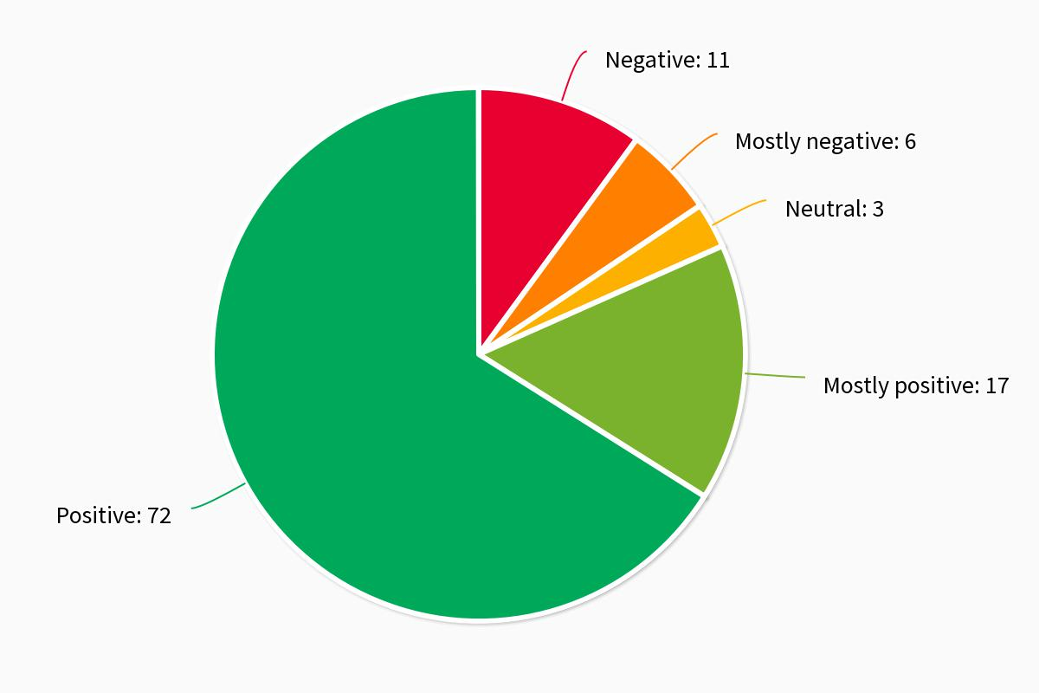
Contributions sentiment – whole project

Slide 6
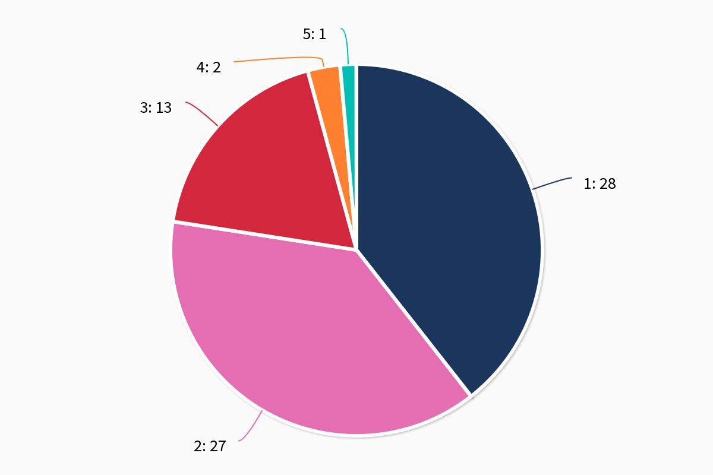
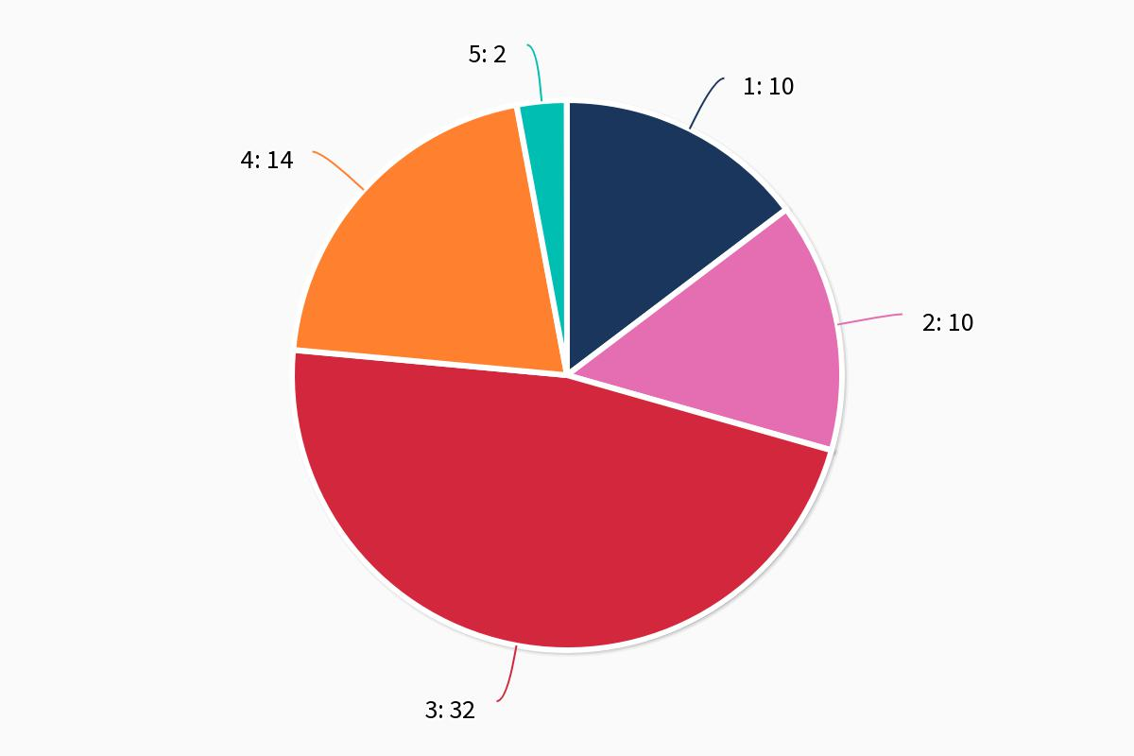
Net Zero: Retrofit
How confident do you feel that the issue is being addressed at present?
How confident do you feel that this issue would be addressed if the proposals set out in this report were adopted?

Slide 7
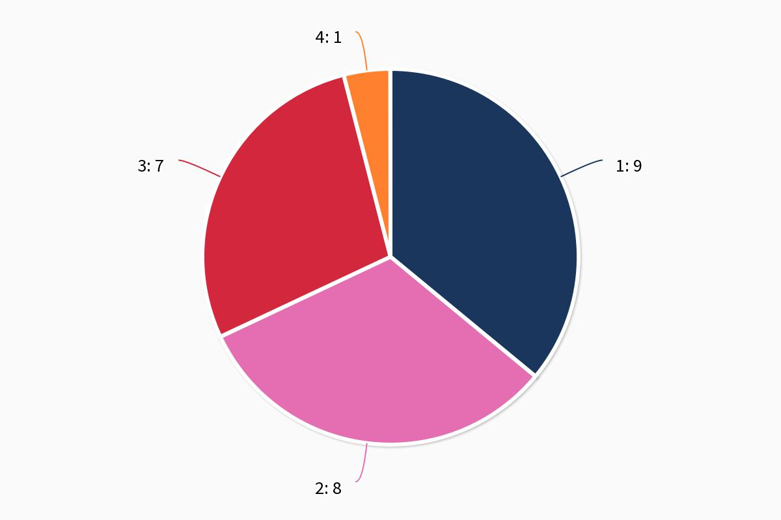
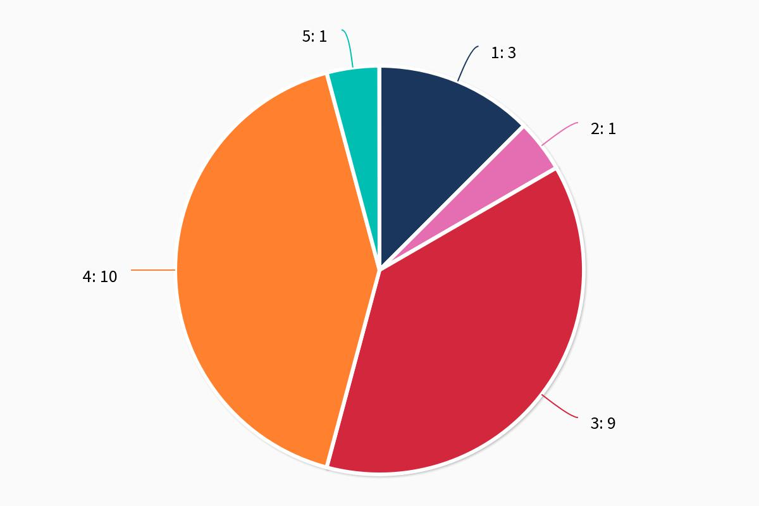
Land, Water, Nature, Food: Regional food systems
How confident do you feel that the issue is being addressed at present?
How confident do you feel that the issue would be addressed if the proposals set out in this report were adopted?

Slide 8
Social media: Twitter
@YHClimateCom
Followers: 1,954 (up by 689 since Nov 21)
Engagement rate (any time a user engages with a tweet): 3.7% in last 90 days (anything over 1% is good!)
Engagement rate was particularly high for tweets about our letter to the PM (8.1%), writing to Drax (5.7%) and new pledge signatories (5.3%)
Impressions (number of times a Tweet has been seen) for the period were 66.6K (compare with 2.5k in Sept 21)

Slide 9
Social media: other channels
LinkedIn: YHCC has a public page (346 followers) and a private group (unlisted, 29 members).
Analytics – 90 days (page):
Page views up 66%; unique visitors up over 90%
Big spike on day of summit (mobile views especially)
Demographics show vast majority of visitors were in business development (key audience for the pledge)
Instagram: yorkshire_humber_climate_comm (launched Nov 22)
54 followers
Facebook (launched Nov 22): 3 followers (needs paid promotion)

