Slide 1



















Introducing THE YHCC
An independent advisory collective that supports, facilitates and enables ambitious climate action across the region
Established in March 2021, the Commission is the largest regional Commission in the UK and brings together climate leaders from across the public, private and third sectors
Chair, 4 political Vice Chairs, 40 Commissioners plus Associates & Affiliates… and 100+ pledge signatories
Funders
Examples of Supporters

Slide 2



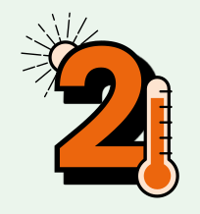

Four Pillars of Climate Action
The Commission promotes action across all four pillars of climate action.
These are embedded in the region’s Climate Action Plan.
1. Rapid emissions reduction Cut our greenhouse gas emissions rapidly, through expansion of renewable energy, upgrading our homes and businesses to reduce their energy demand, changing the way we travel and restoring our peat bogs.
3. Nature restoration Restore nature, by expanding protected areas and creating habitat corridors that enable species to thrive in rural and urban areas and promote nature-based solutions that help tackle the climate crisis.
2. Climate adaptation & resilience Adapt our homes and communities, our water, energy, transport and communications infrastructure, our farming and food systems, and our nature and biodiversity, to increase our resilience to climate impacts such as extreme weather.
4. A just transition Ensure that all actions we take to become climate ready and cut emissions are fair and just. We need to design a transition that creates good jobs, improves health and wellbeing, and provides opportunities for all.

Slide 3



www.climateactionpledge.org.uk

Slide 4

THE CLIMATE ACTION PLEDGE
The Yorkshire & Humber Climate Action Pledge is a public statement of intent to take action on the four pillars of climate action.
It can be taken by any organisation with a base in the region, whether you are already taking steps to act on climate and nature or just starting out.

Slide 5
THE CLIMATE ACTION PLEDGE
Pledge signatories agree that action will be most effective if it is carried out according to these four principles:
Strong leadership
Engaged employees
Engaged stakeholders
Fairness and inclusion

Slide 6
A valuable declaration
Pledge signatories become part of a network of organisations and businesses who:
Have made a public statement of intent to take action for climate and nature
Support each other with knowledge sharing, advice and empathy
Can access support from the wider Commission network
Meet at networking events organised by the YHCC – like this one!
Receive information from the YHCC about useful resources, tools and opportunities

Slide 7










































Who has signed?

Slide 8
SIGN THE PLEDGE
www.climateactionpledge.org.uk

Slide 9
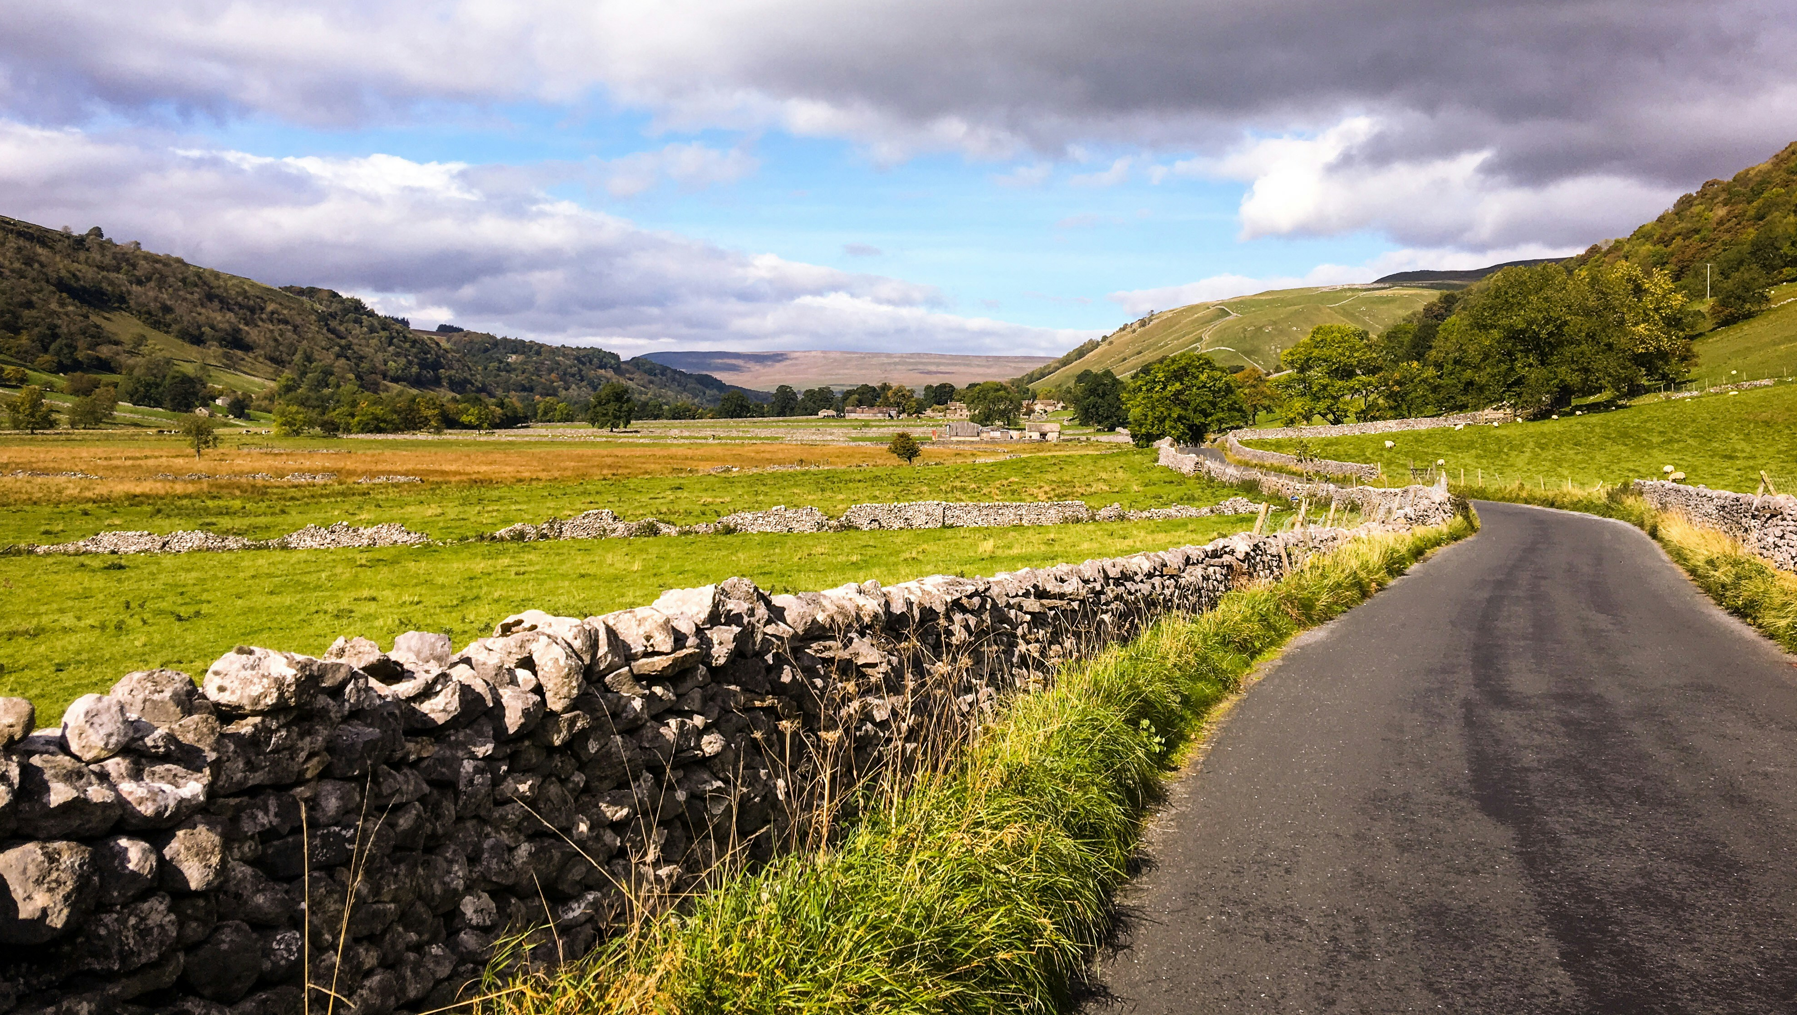
WHERE ARE WE NOW?
Regional context gathered through our Delivering Impact programme
Photo by Gary Butterfield on Unsplash

Slide 10
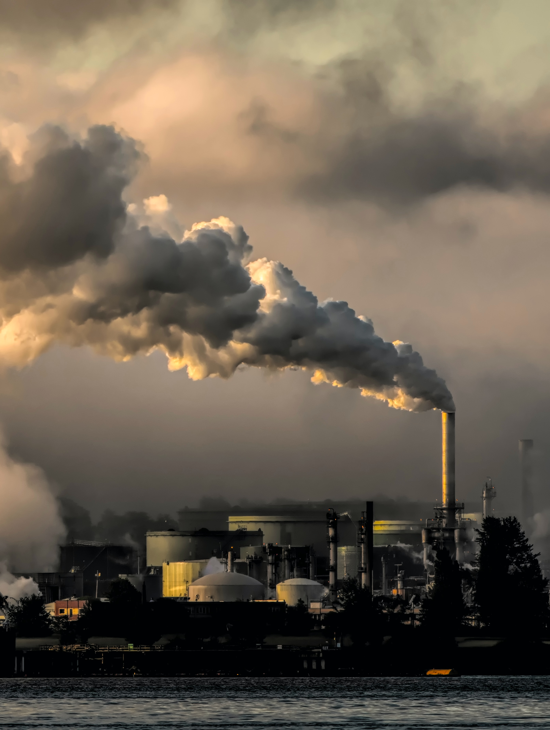
Generating power
Despite the UK reaching a record 50.8% of electricity produced by renewables, oil and gas use is still increasing each year
16.5% of people in Y&H are living in fuel poverty
There are social and ecological implications of technologies such as biomass, offshore wind and carbon capture and storage that must be addressed
Energy Trends September 2025
Sub-regional fuel poverty in England, 2023 - GOV
Trade-offs: BECCS | Oxford Academic (oup.com)
Marine Considerations YHCC YouTube
Photo by Chris LeBoutillier on Unsplash
Notes:
CHAIR

Slide 11
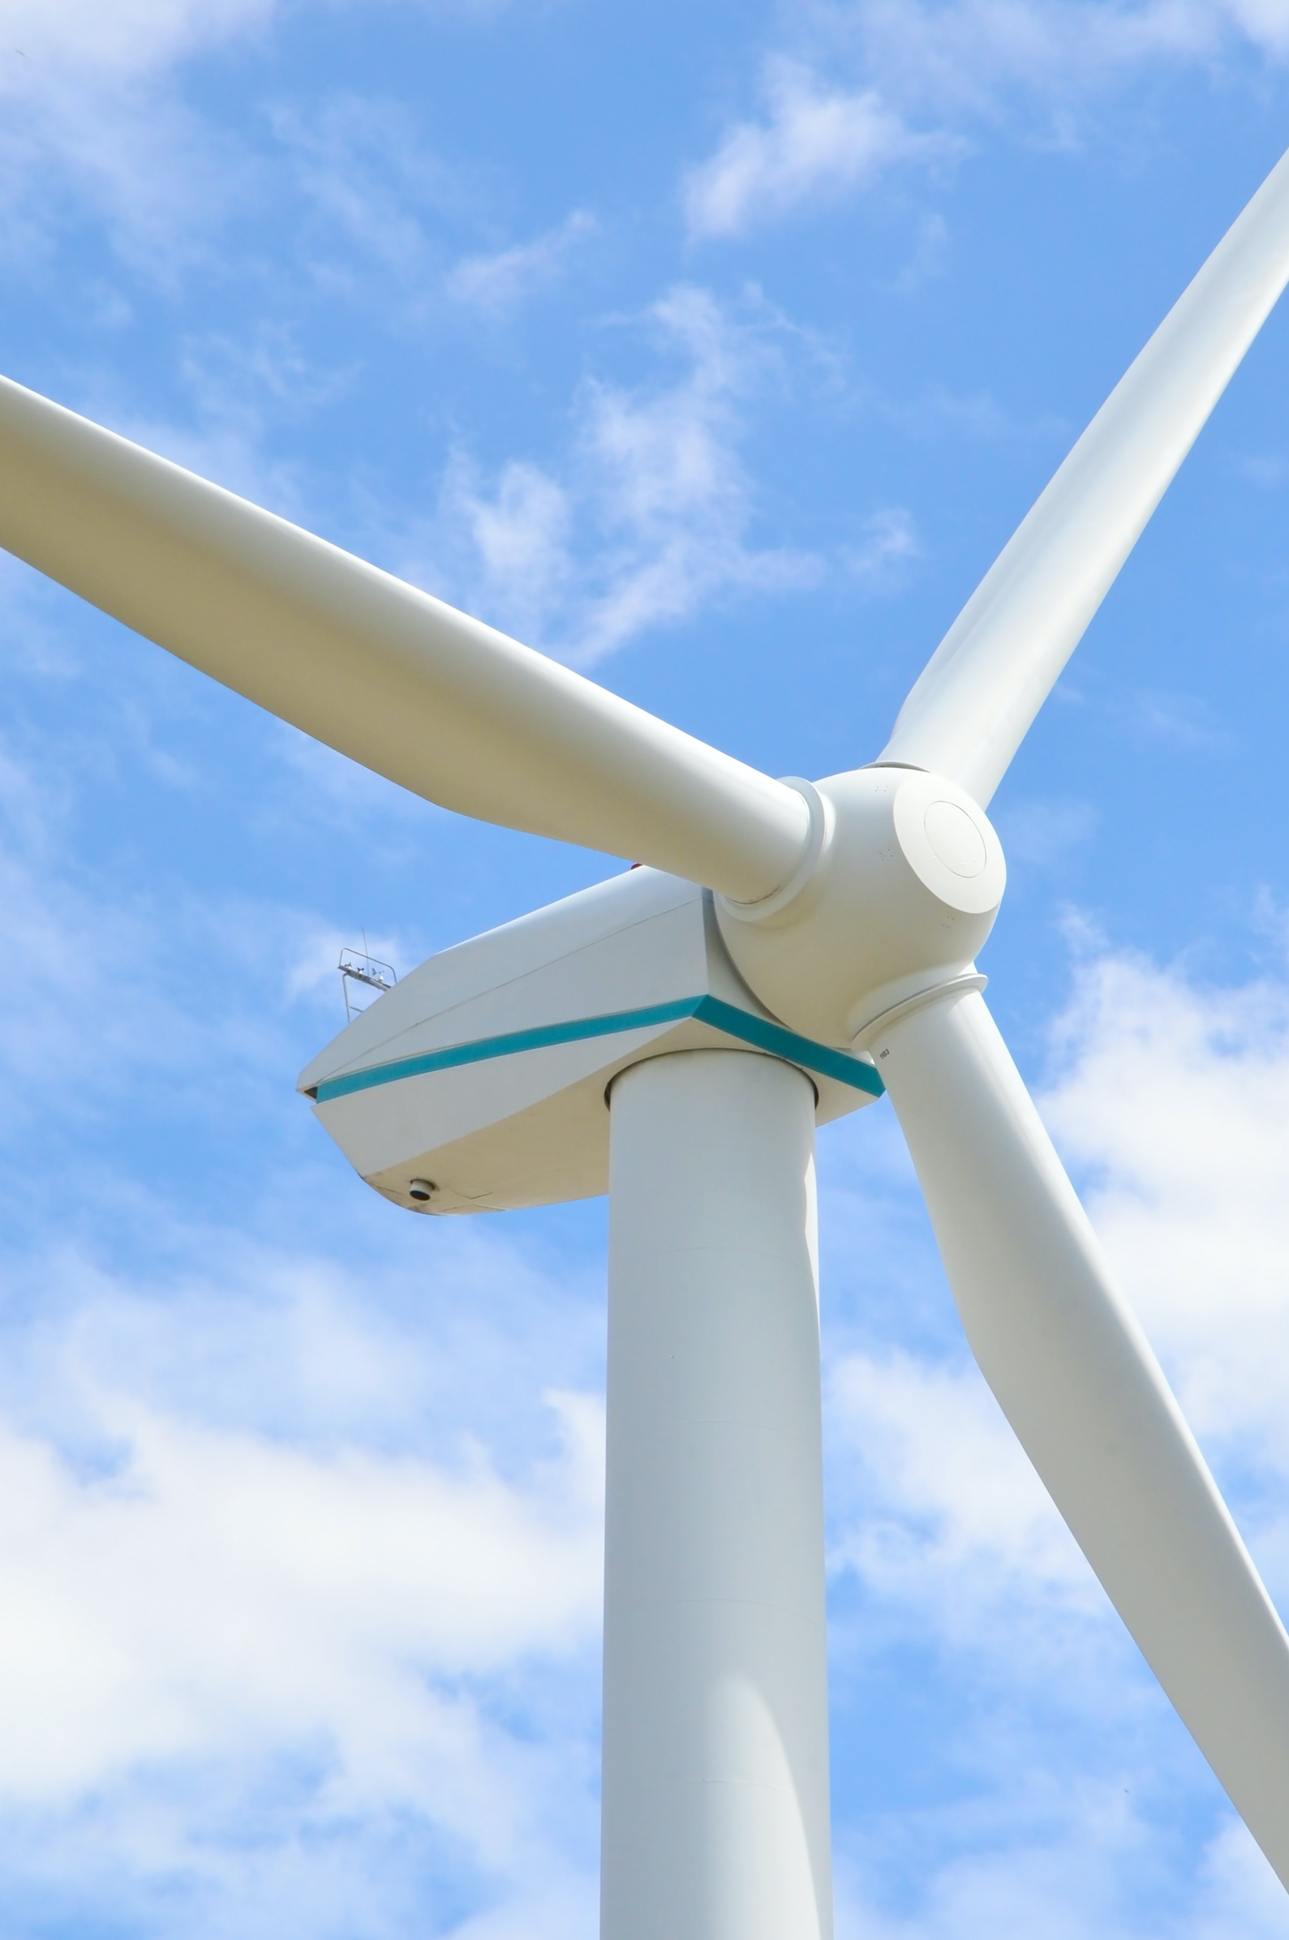
Renewable
Energy
76% of people support renewable energy projects in their local area
100,000 jobs could become available in the north of England in the transition to low carbon energy
The Humber is the UK's largest industrial decarbonisation opportunity
The social return on investment of community fuel poverty alleviation projects is estimated at £9 for every £1 spent
Renewable UK polling research
Review of Energy Policy 2021 (rl.ac.uk)
final_humber_2030_vision.pdf (cbi.org.uk)
Capturing the value of community fuel poverty alleviation (bristol.ac.uk)
Photo by Artur Zudin on Unsplash
Notes:
CHAIR

Slide 12

Existing Homes
Homes account for 19% of UK emissions
2.3 million homes in Yorkshire and Humber, 85% of which have EPC ratings C or below
Need to retrofit 1.5 homes per minute for next 30 years to meet national net zero target
The UK will experience higher frequency and more intense heatwaves, and homes are not equipped for these high temperatures.
YHCC carbon reduction report
Energy Performance of Buildings Data England and Wales (opendatacommunities.org)
Net Zero Strategy: Build Back Greener - GOV.UK (www.gov.uk)
Extreme heat preparedness and resilience in the UK - (lse.ac.uk)
Photo by Louis Reed on Unsplash
Notes:
CHAIR

Slide 13
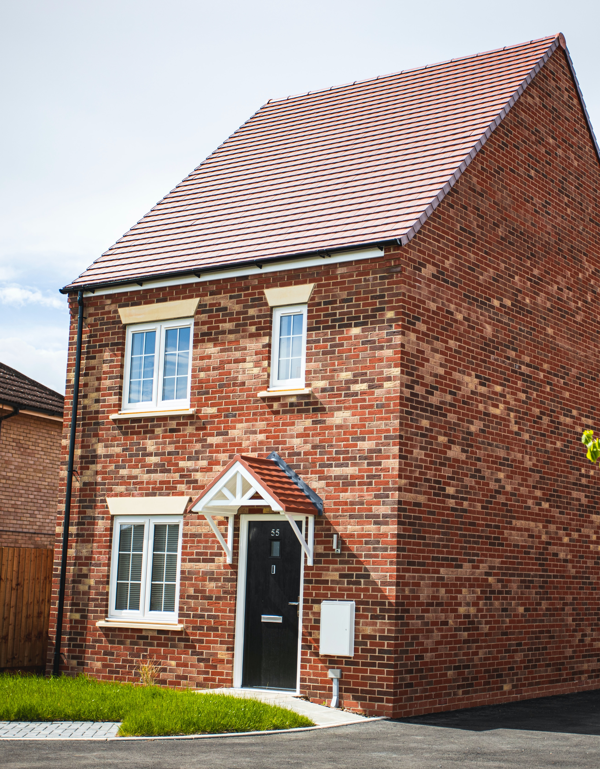
New homes
19,986 new homes built in Y&H in 2017-18
Quality assurance of new builds are rarely carried out, resulting in low quality housing
Heat loss in new houses can be 50-60% more than the design predictions
The cost of running or retrofitting new builds is five times higher than designing in high standards
House building in Yorkshire & the Humber (hbf.co.uk)
New Build and Planning YHCC - YouTube
Performance Gap – The Buildings Hub
UK housing: Fit for the future? - Climate Change Committee (theccc.org.uk)
Photo by James Feaver on Unsplash
Notes:
CHAIR

Slide 14
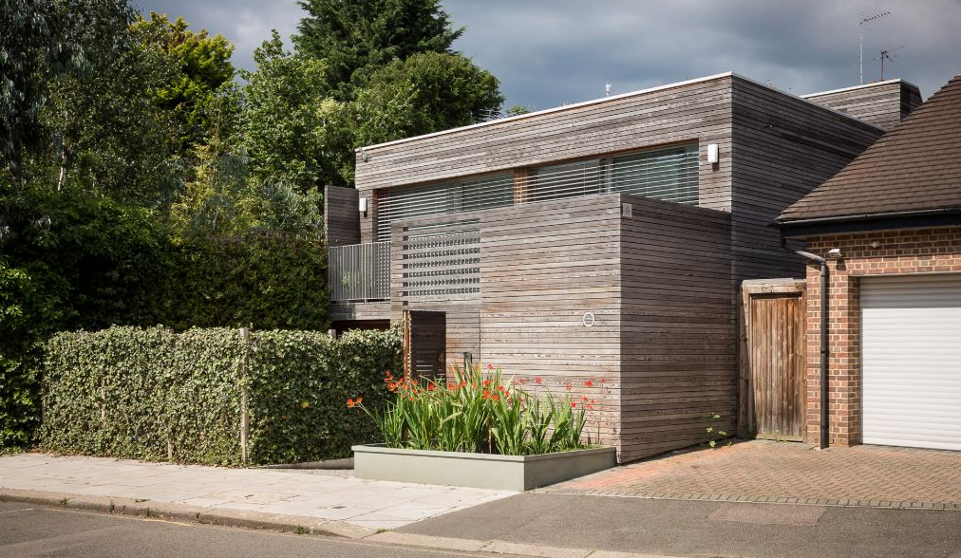
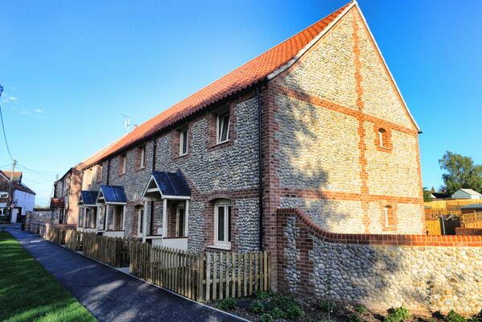
New home opportunities
Active building design and off-site construction can improve quality by 95% and reduce energy use by 75%
Passivhaus is a high efficiency build standard that typically reduces energy use by 50%
We're sitting in the midst of Citu's Climate Innovation District in Leeds. Citu are focused on creating beautiful places, with high-performance buildings, where people can lead a happy low carbon life
New Build and Planning YHCC - YouTube
2021 PHT (passivhaustrust.org.uk)
Images – UK examples of Passivhaus (passivhaustrust.org.uk)
Notes:
CHAIR

Slide 15
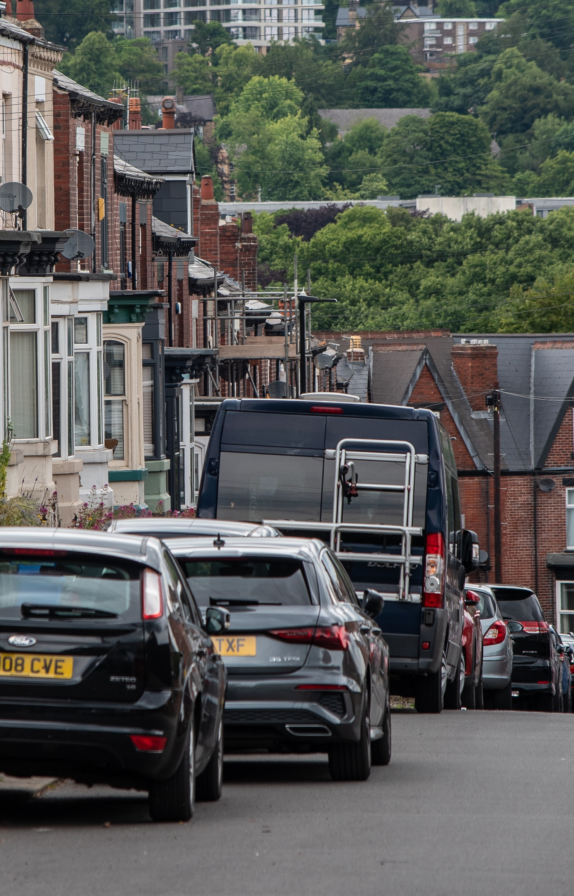
Transport
Transport is responsible for 29% of our direct emissions
27.3 billion vehicles miles were travelled in Y&H in 2022
Average of 14,676 road casualties a year in Y&H
Poor transport infrastructure puts 22% of people in the region at risk of social exclusion
Transport spending plans will invest £3,636 per person in London, compared to £511 in the North
Net zero carbon roadmap analysis Yorkshire and Humber 2024
Road Accidents and Safety Statistics | Gov.uk
Reported road collisions, - GOV.UK (www.gov.uk)
Strategic Transport Plan | Transport for the North
North set to receive £2,389 less per person than London | IPPR
Photo by Benjamin Elliott on Unsplash
Notes:
CHAIR

Slide 16
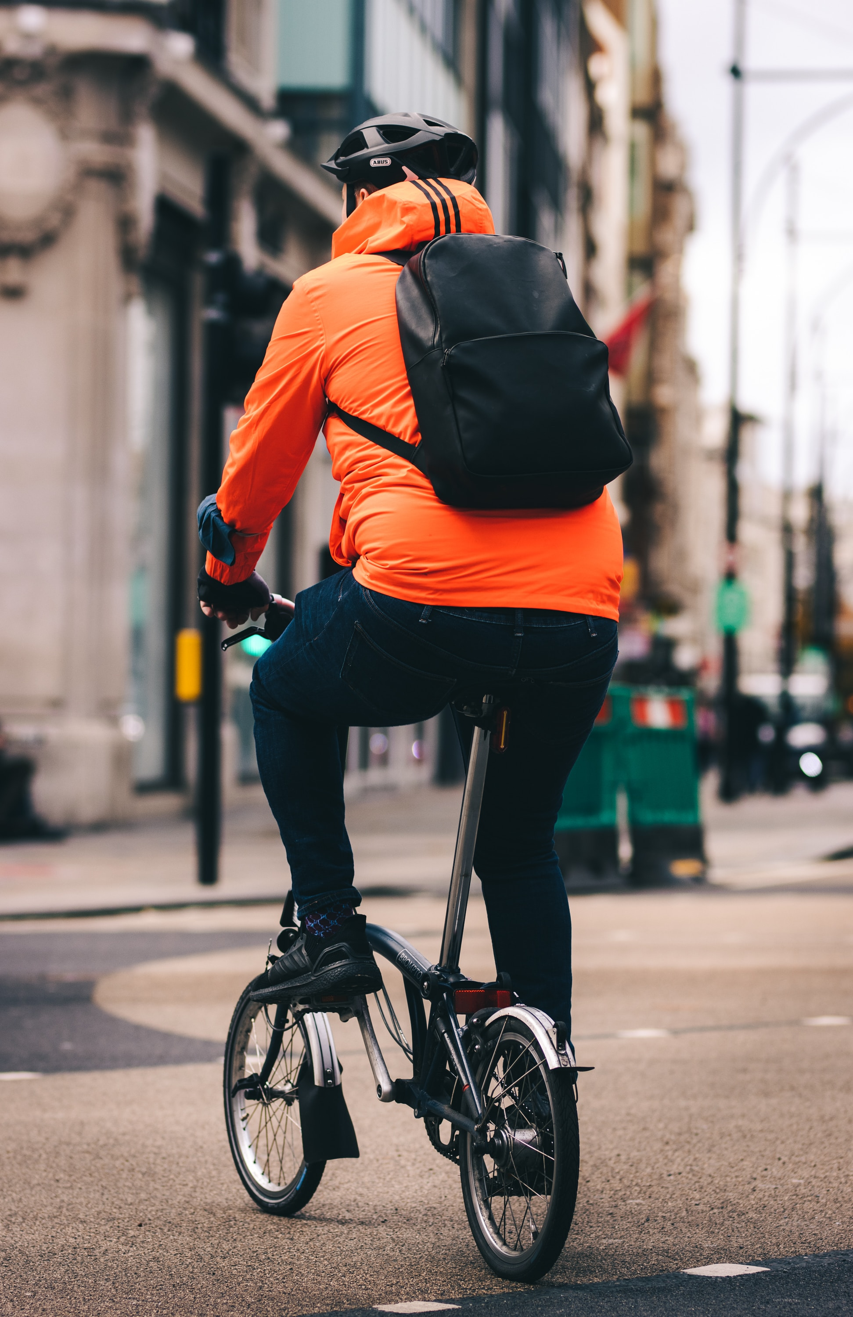
Better travel
York and North Yorkshire's carbon roadmap aims for a 48% reduction in private car usage by 2030
Upgrades to UK public transport could deliver an estimated £52bn boost in productivity by 2030
The 'quiet majority' are supportive of changes that enable more walking and cycling
Increasing walking and cycling rates could prevent 134 early deaths each year in Y&H
York & North Yorkshire's Route map to Carbon Negative | YNYLEP
Public Transport Upgrade could provide £53 billion productivity boost | TUC
Public attitudes towards traffic, road use and low-traffic neighbourhoods | Gov.uk
Health benefits of active travel
Photo by Jordan Brierley on Unsplash
Notes:
CHAIR

Slide 17
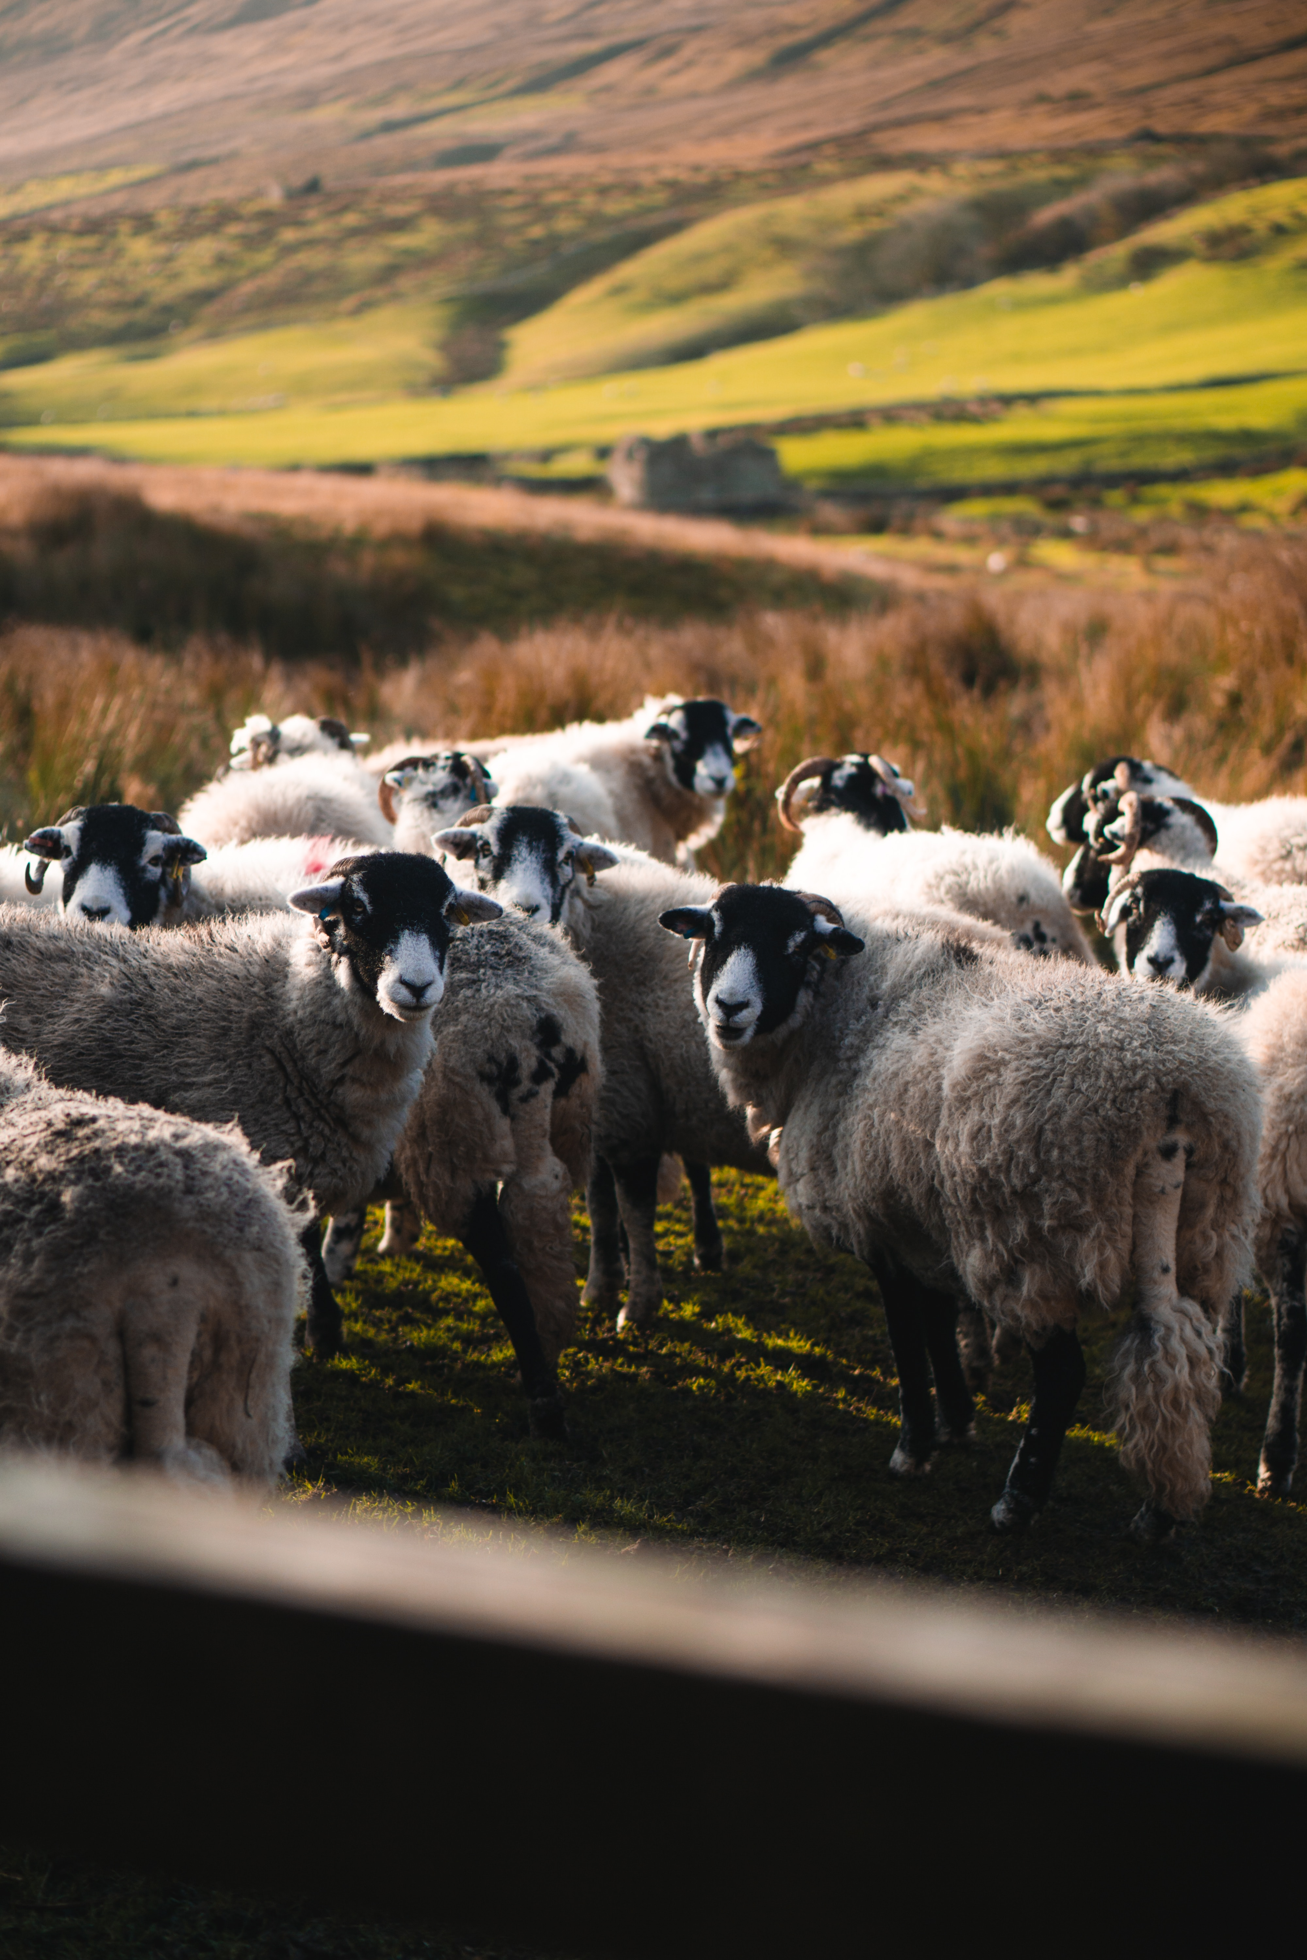
Our Food system
20.6% of people in Y&H experienced food insecurity in 2022
Yorkshire is home to 13-17% of the UK's crop production area and 10-14% of the UK's livestock
70% of the region's land is farmland
Reliance on chemical fertilisers and pesticides degrades soil, leading to diminishing yields in the long-term
46% of our food comes from outside the UK, with climate impacts increasing risks of price rises, disruptions, delays and failures in supply chains
Food Insecurity Tracking | Food Foundation
About FixOurFood - Fix Our Food
Agricultural facts: England regional profiles gov.uk)
United Kingdom Food Security Report 2021 - GOV.UK (www.gov.uk)
Photo by Illiya Vjestica on Unsplash
Notes:
CHAIR

Slide 18
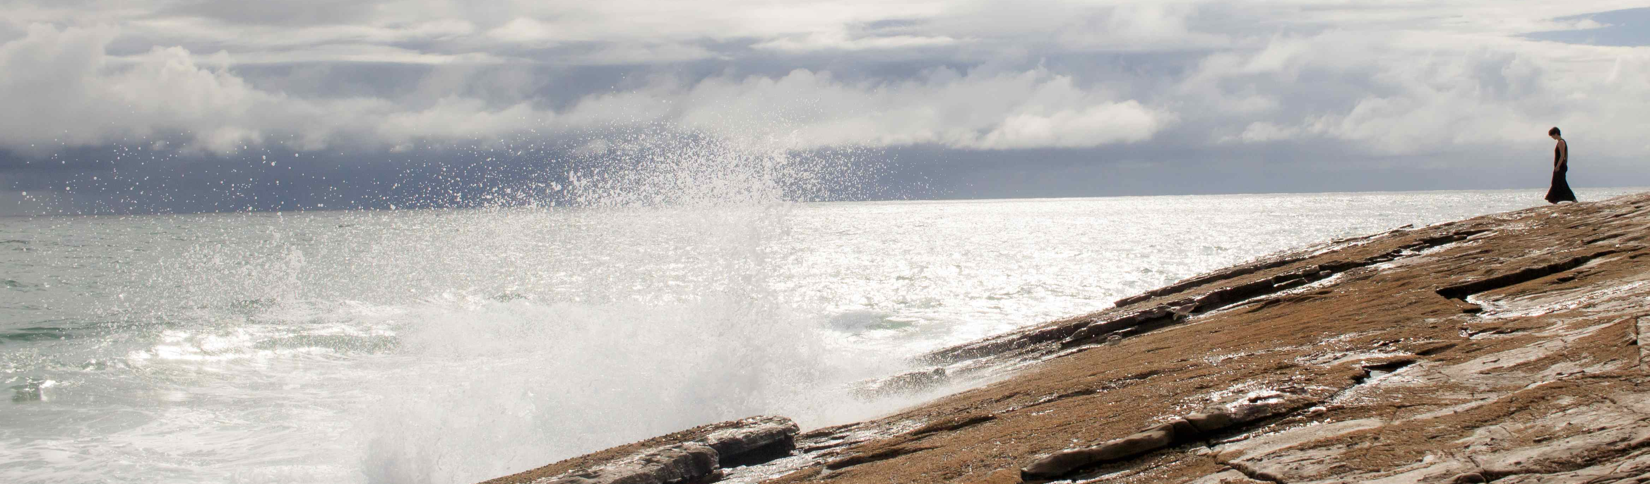
SOPHIA CHENG
With Many Roots
Notes:
CHAIR

Slide 19
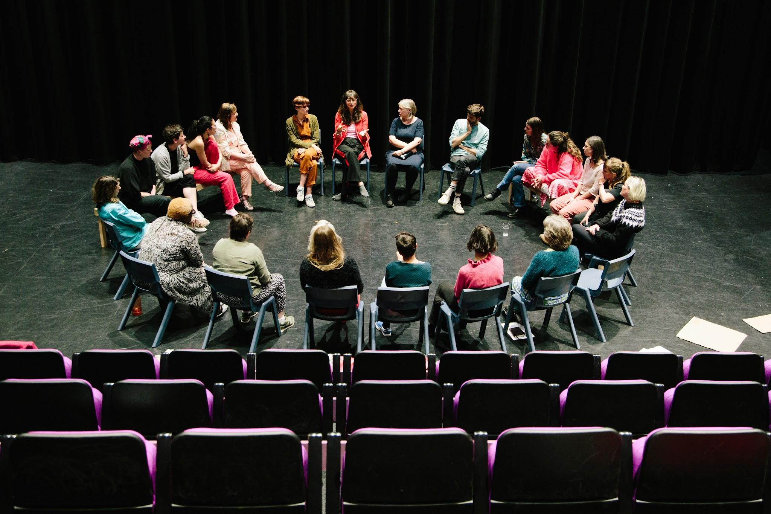
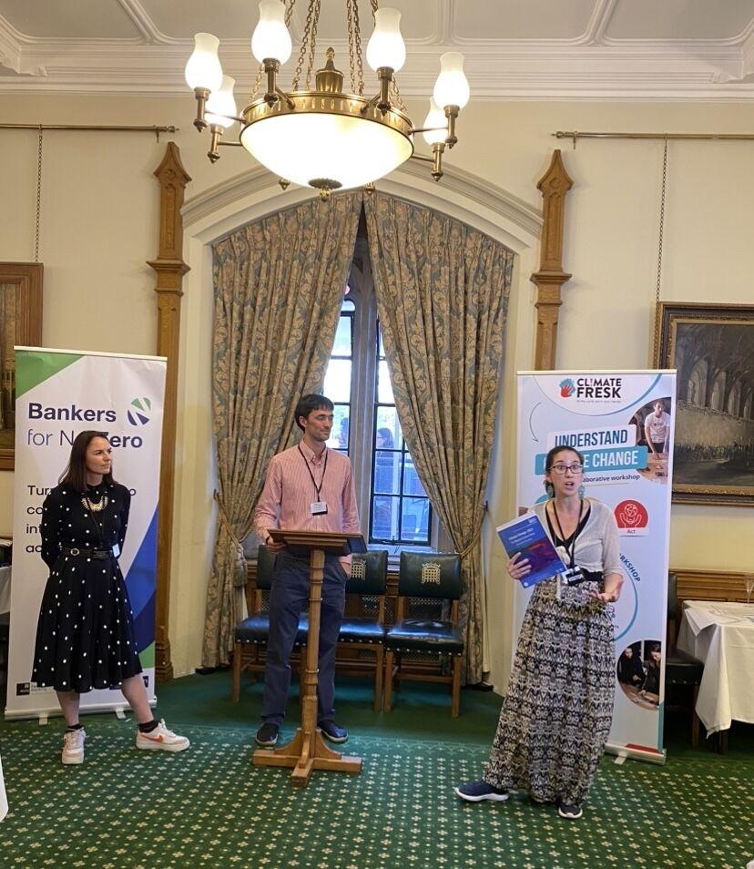
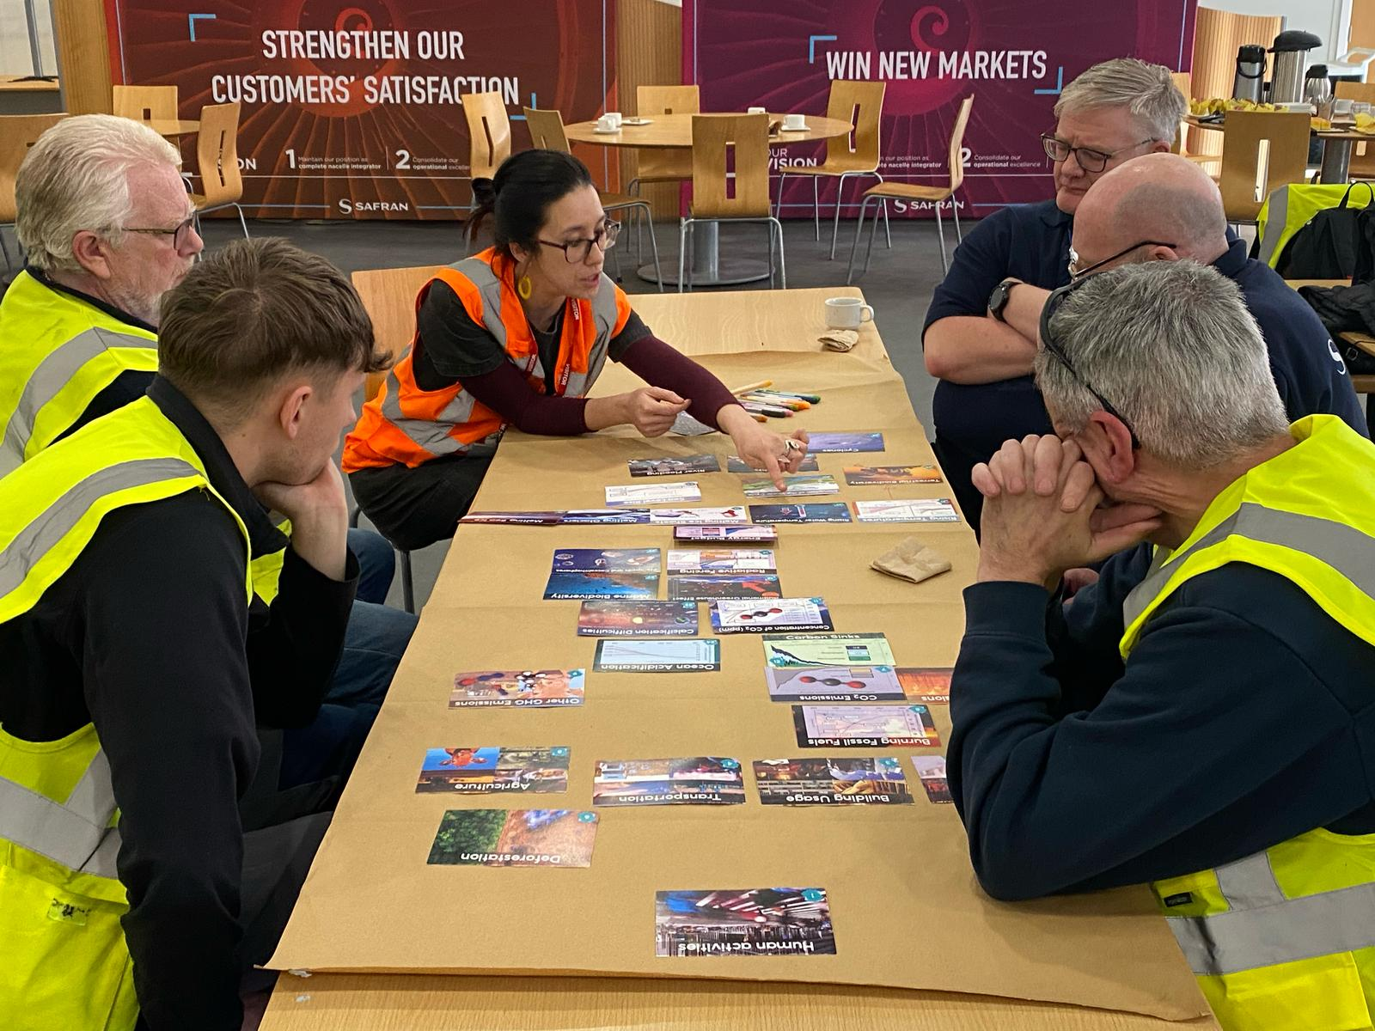
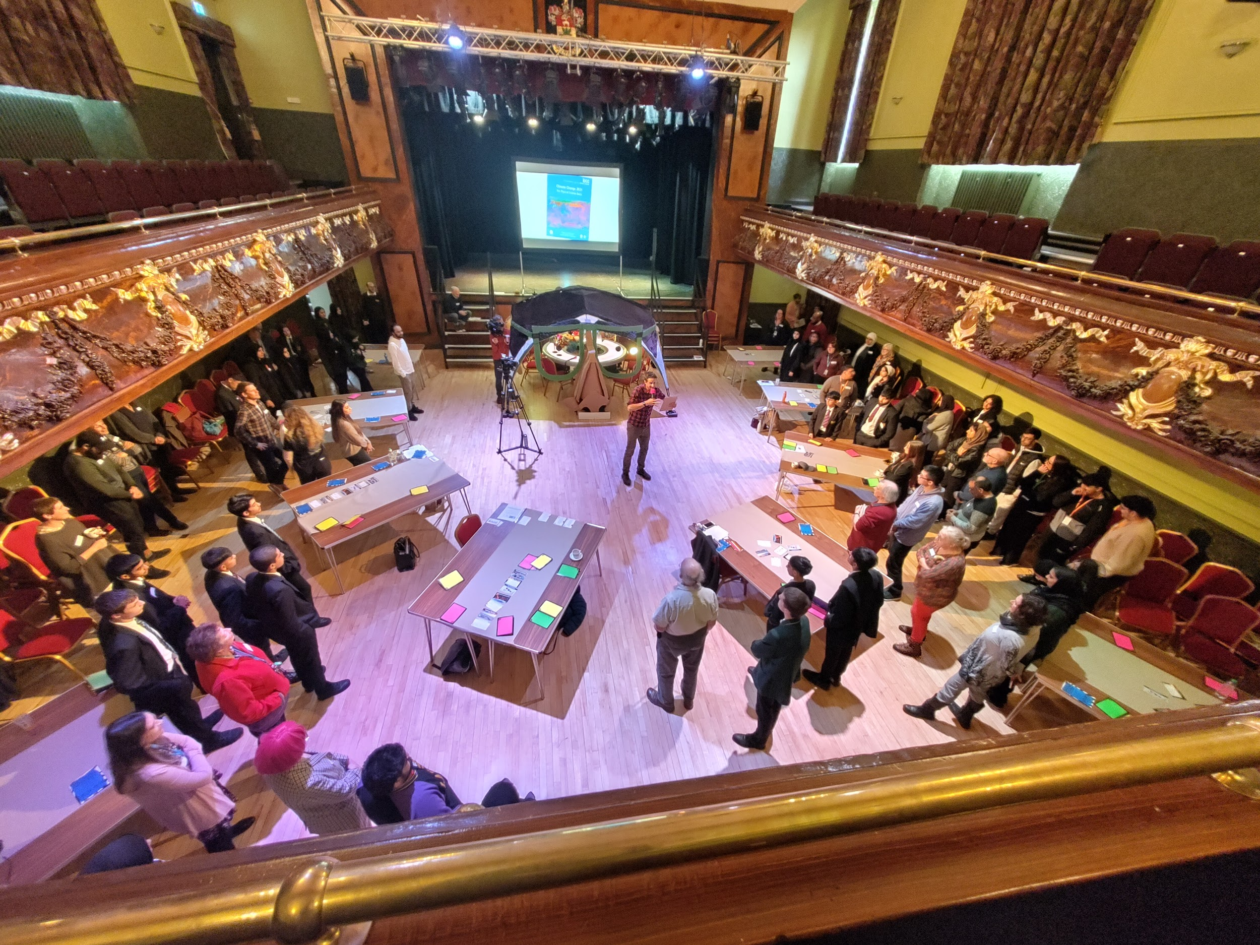
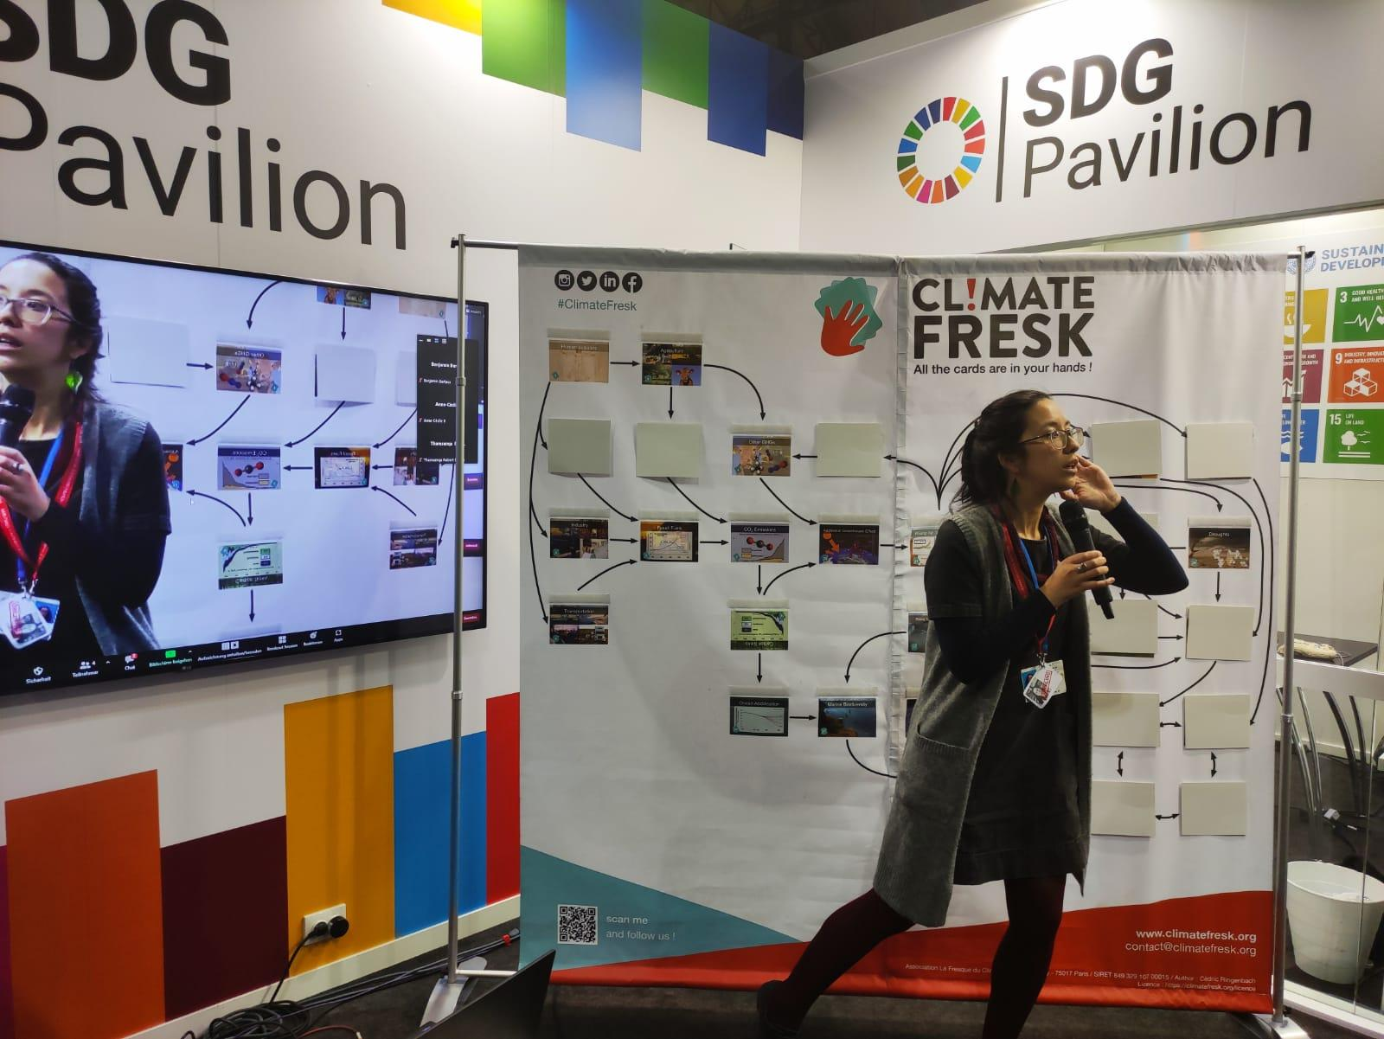
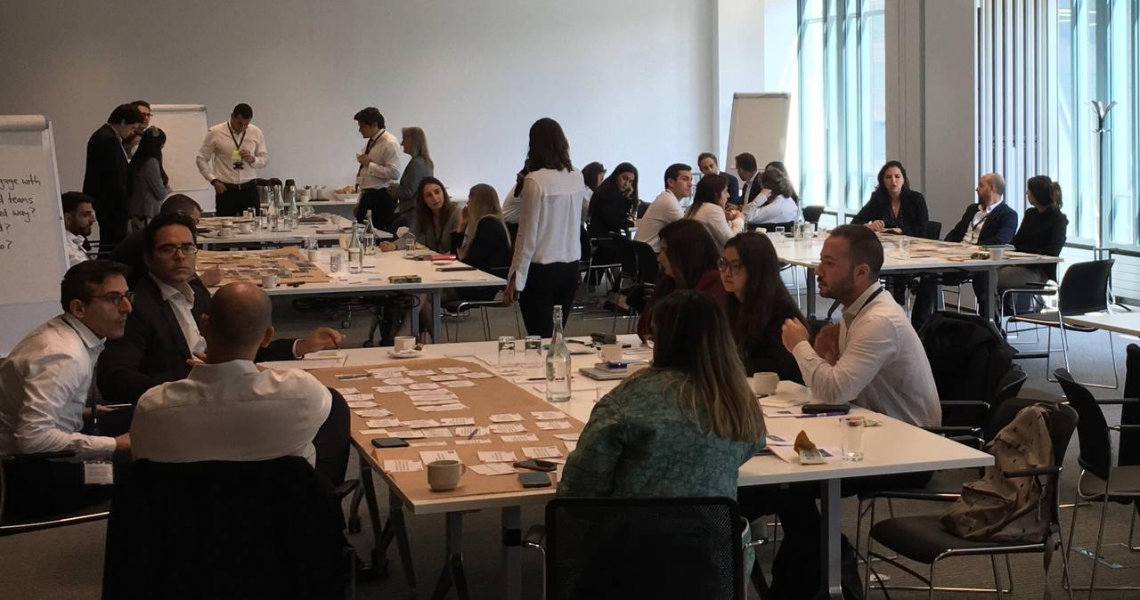
Hi, I’m Sophia
Notes:
Delighted to be here with EVO members today
3 weeks after COP

Slide 20
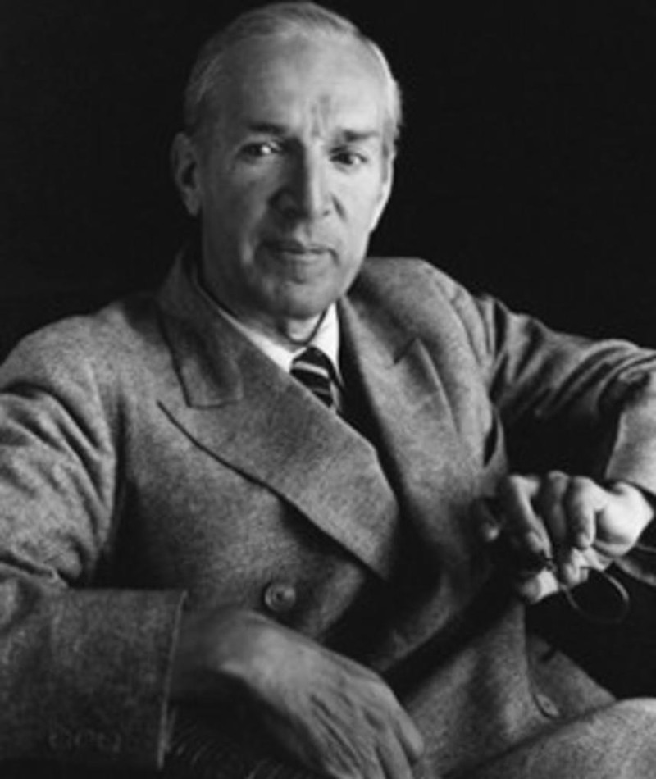
“It is difficult to get someone to understand something when their salary depends on them not understanding it.”
Upton Sinclair
Slide credit: Mike Berners-Lee

Slide 21
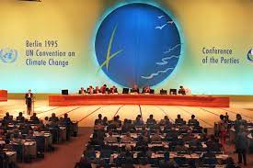

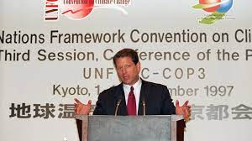

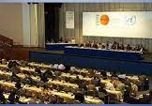





29 COPs…
Slide credit: Mike Berners-Lee

Slide 22
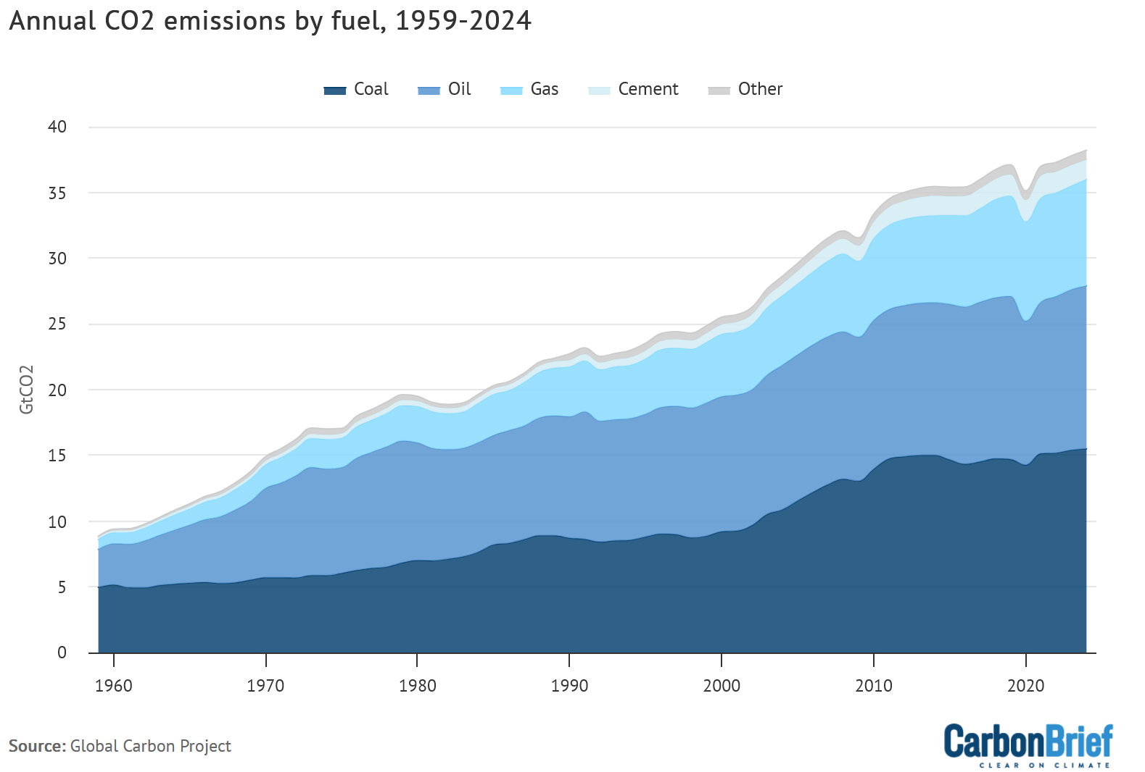
COP 1
1995
Slide credit: Mike Berners-Lee

Slide 23
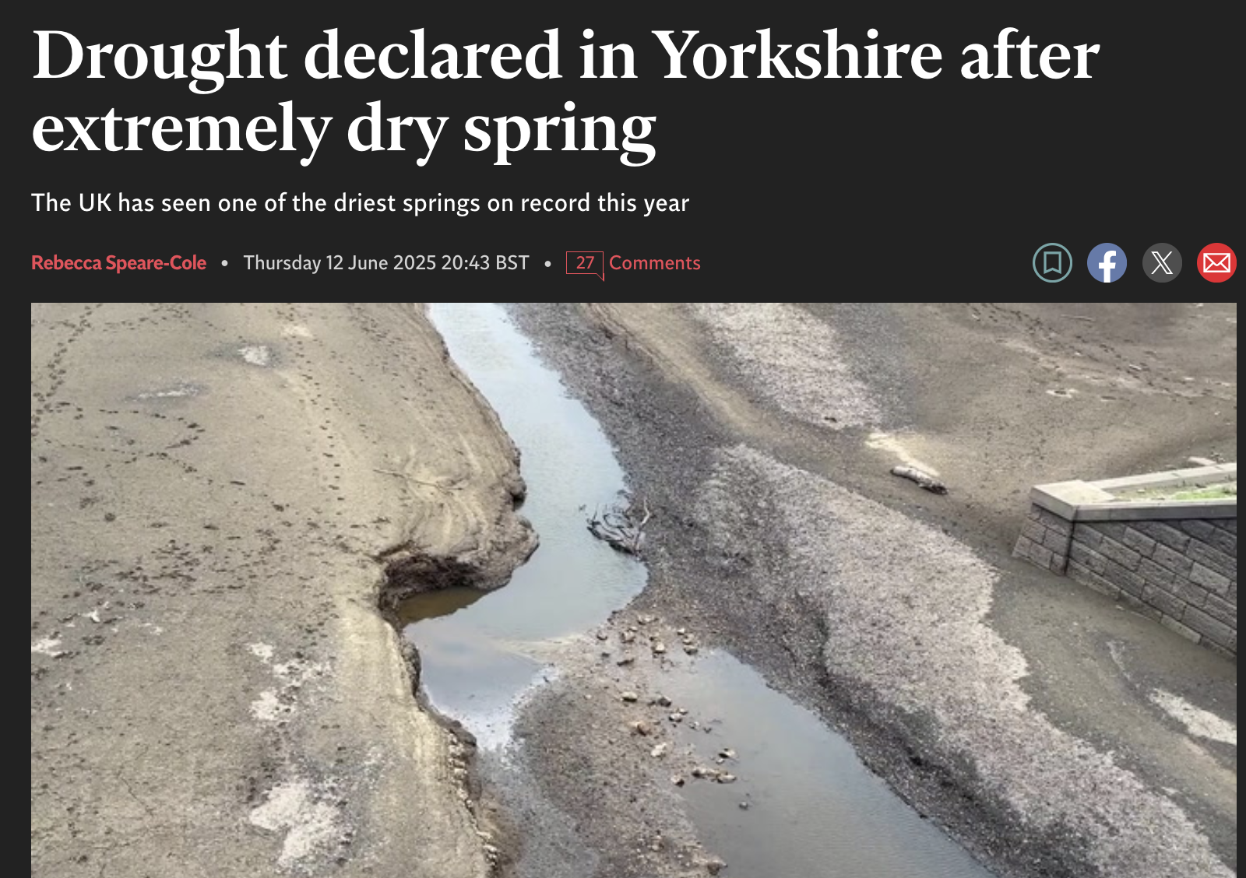
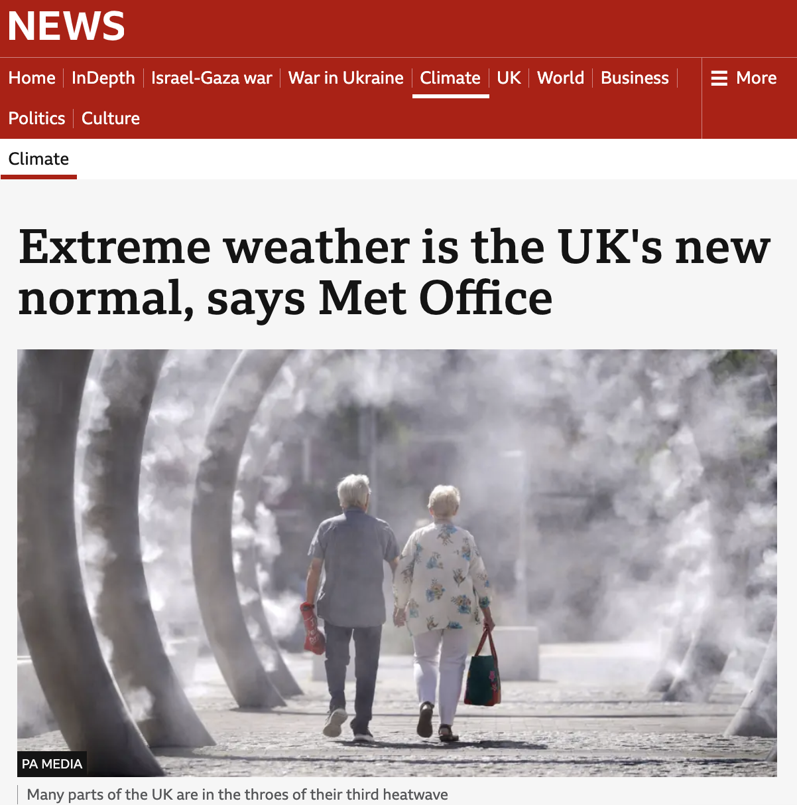
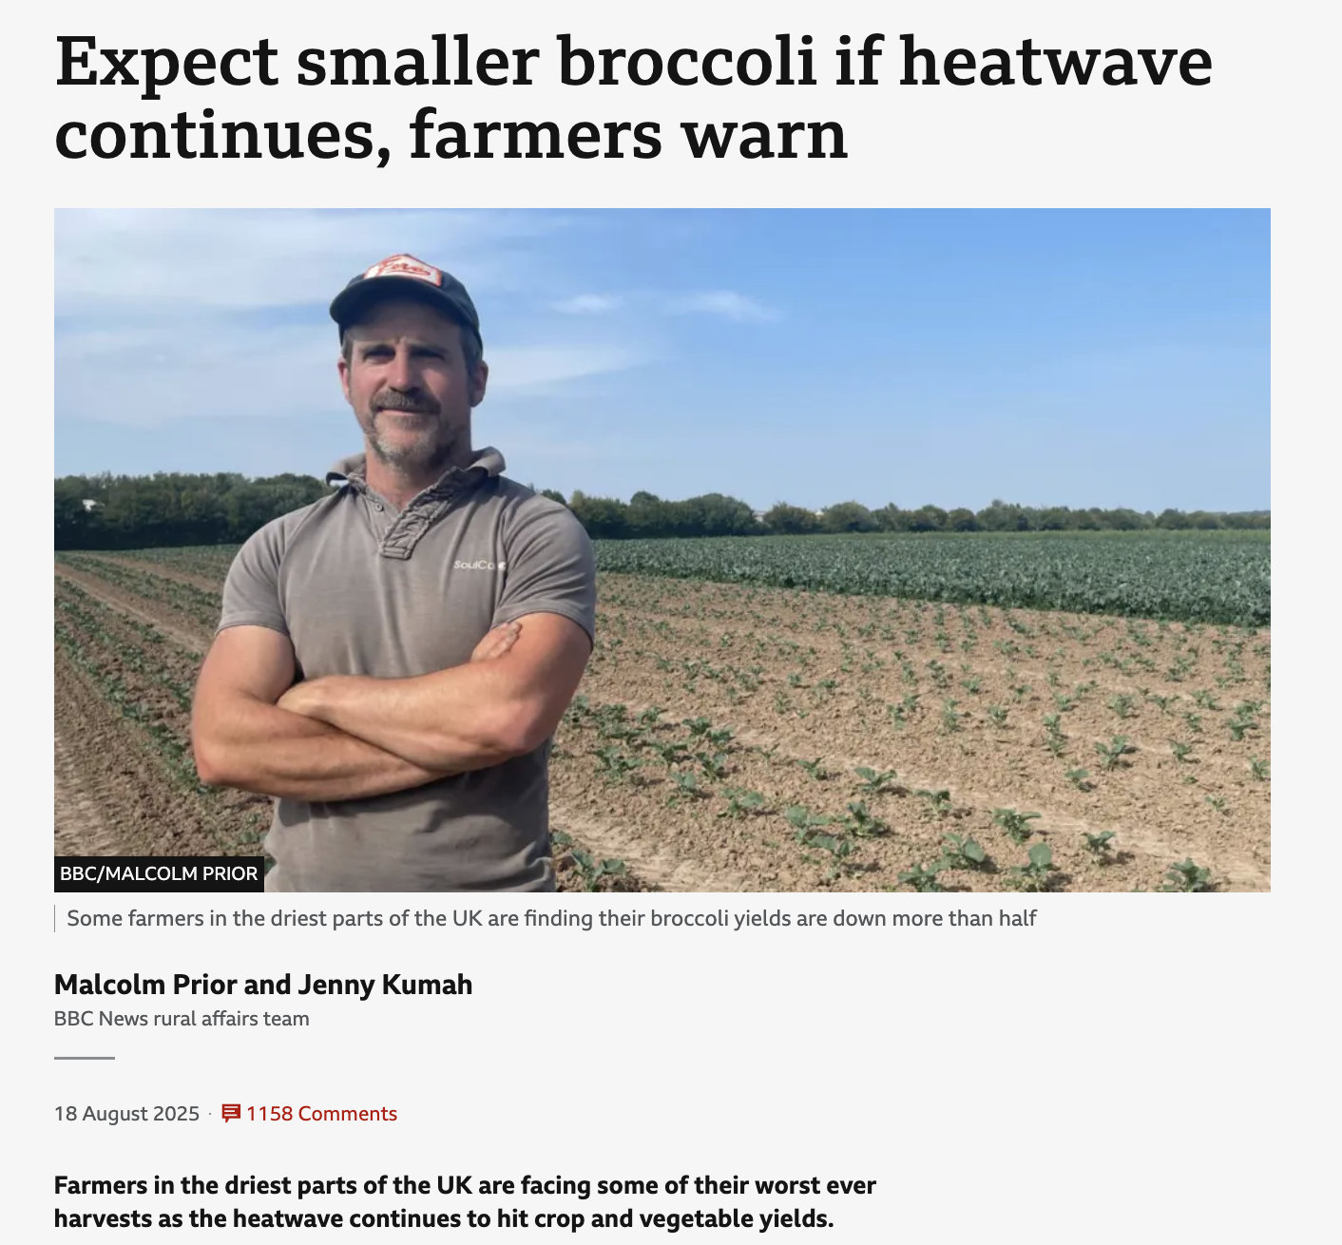
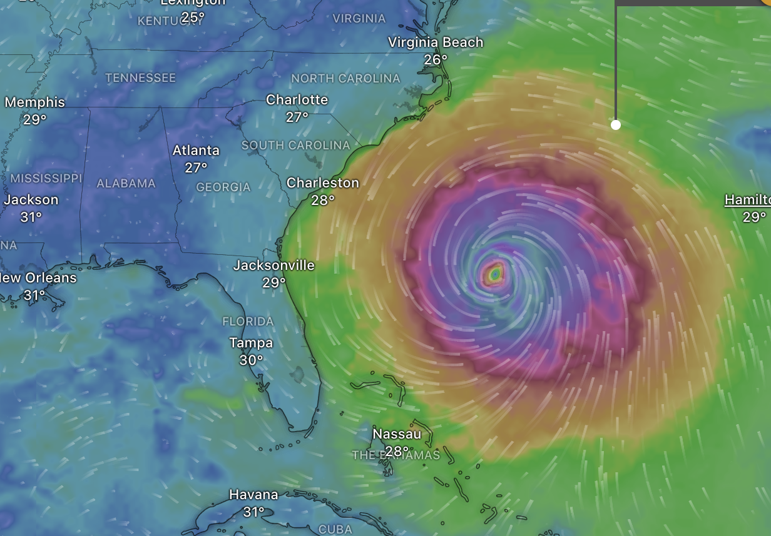
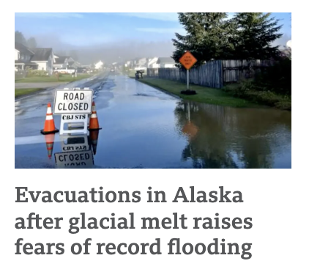
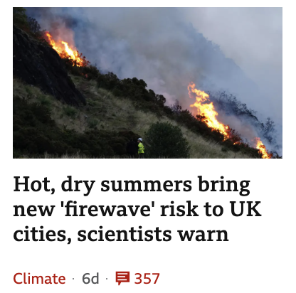

Slide 24
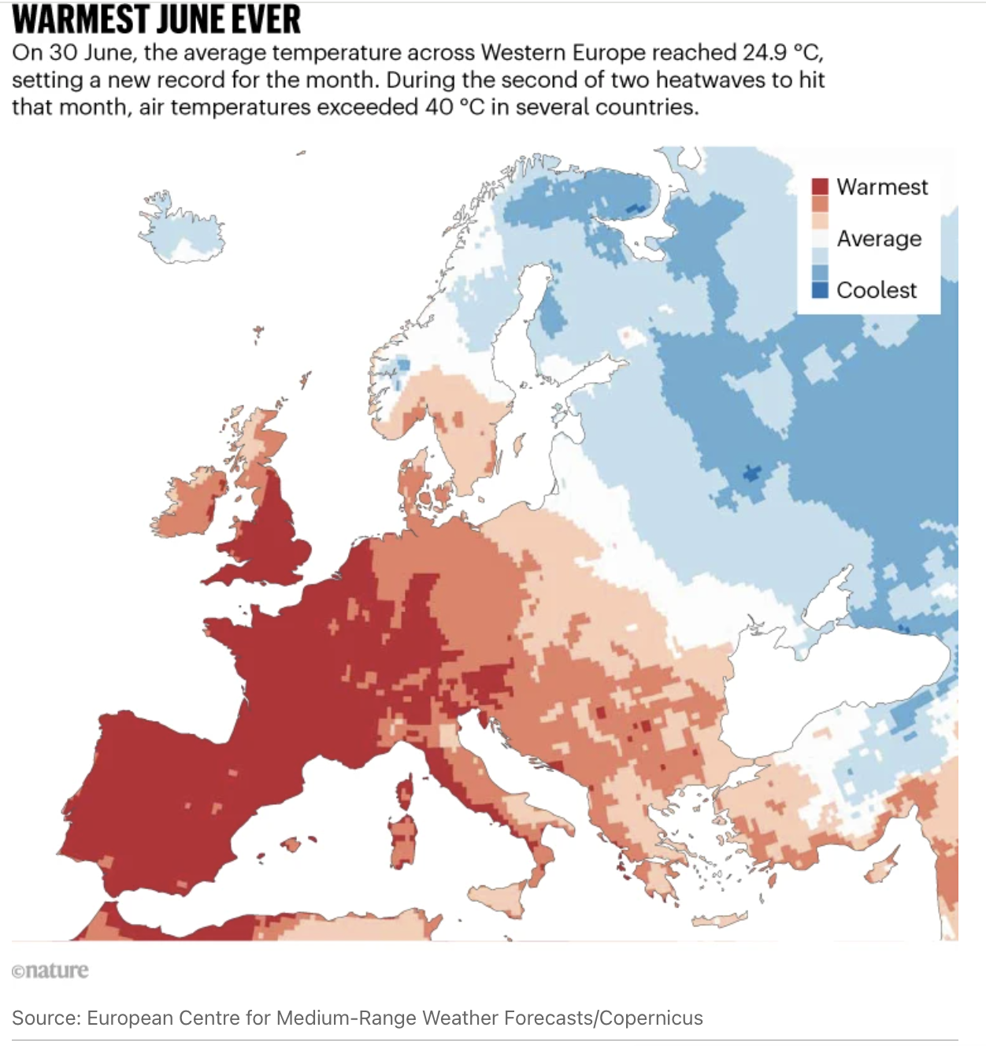
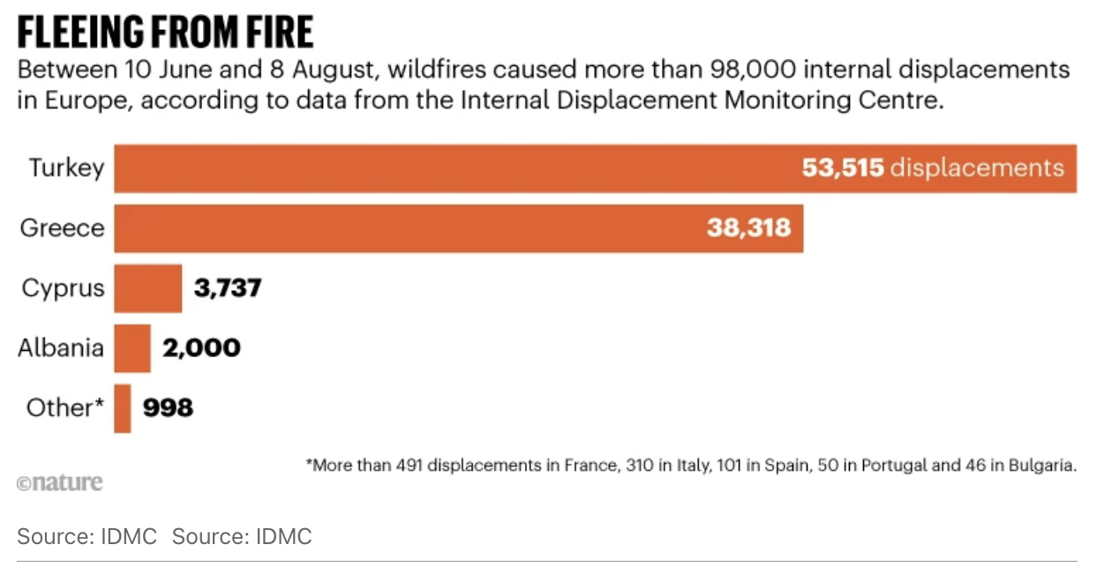
Nature: August 2025

Slide 25
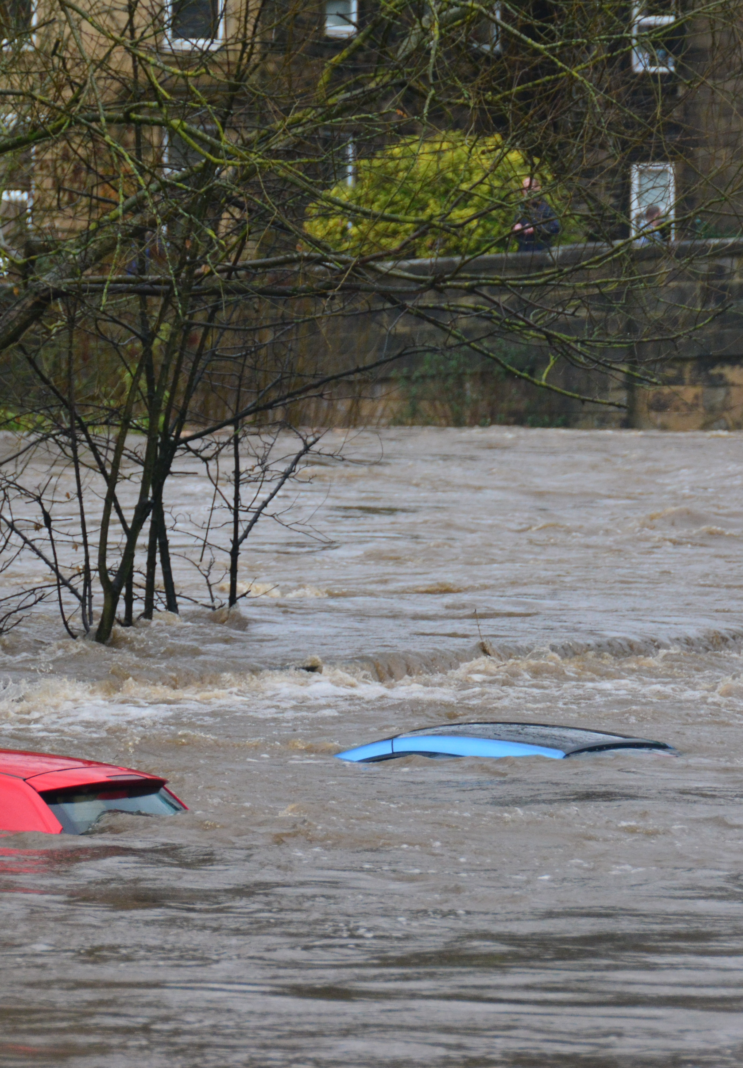
Understanding
the reality
Y&H emitted c.37 million tonnes of carbon in 2024
Y&H is estimated to be the most flood-vulnerable English region
In 2022 temperatures exceeded 40ºC for the first time in Y&H
The Humber could experience sea level rise of 1.3m in the next 100 years
16% of species are threatened with extinction from Great Britain
YHCC Net Zero Roadmap for Y&H
Climate change, justice and vulnerability | JRF​
Record breaking temperatures for the UK - Met Office
Humber 2100+ strategy
State of Nature 2019 - National Biodiversity Network (nbn.org.uk
Photo of River Aire, Bradford by Chris Gallagher on Unsplash
Notes:
CHAIR

Slide 26
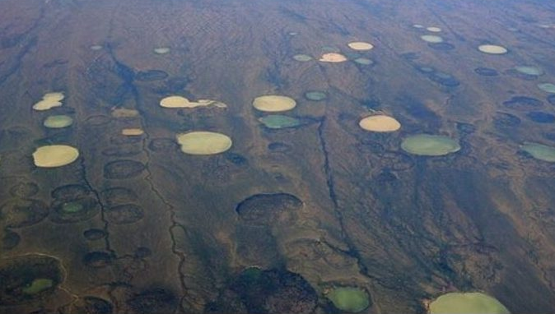
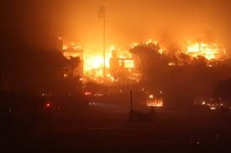
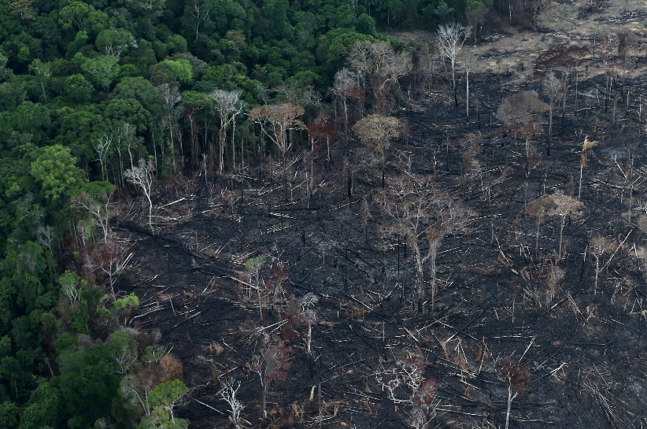
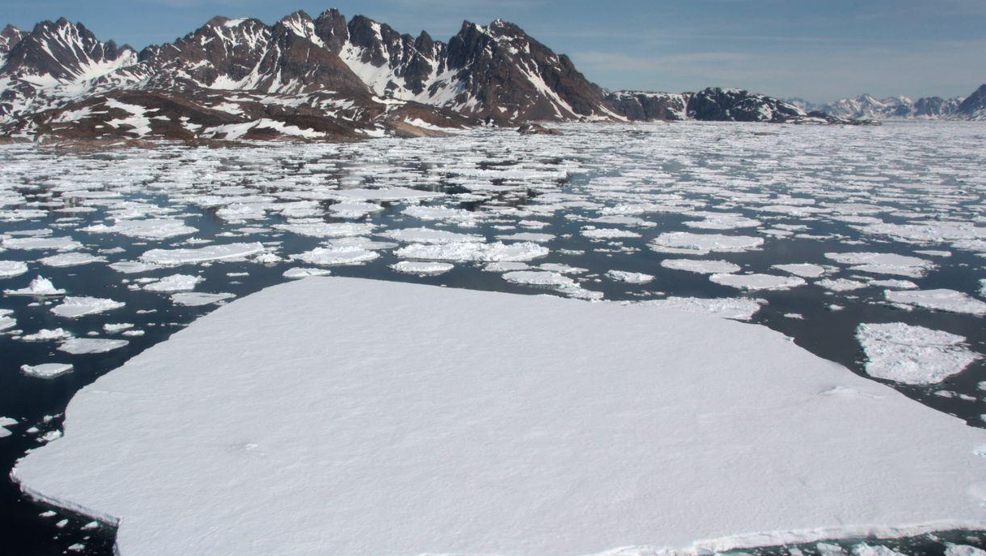
Cascading tipping points?
Slide credit: Mike Berners-Lee

Slide 27
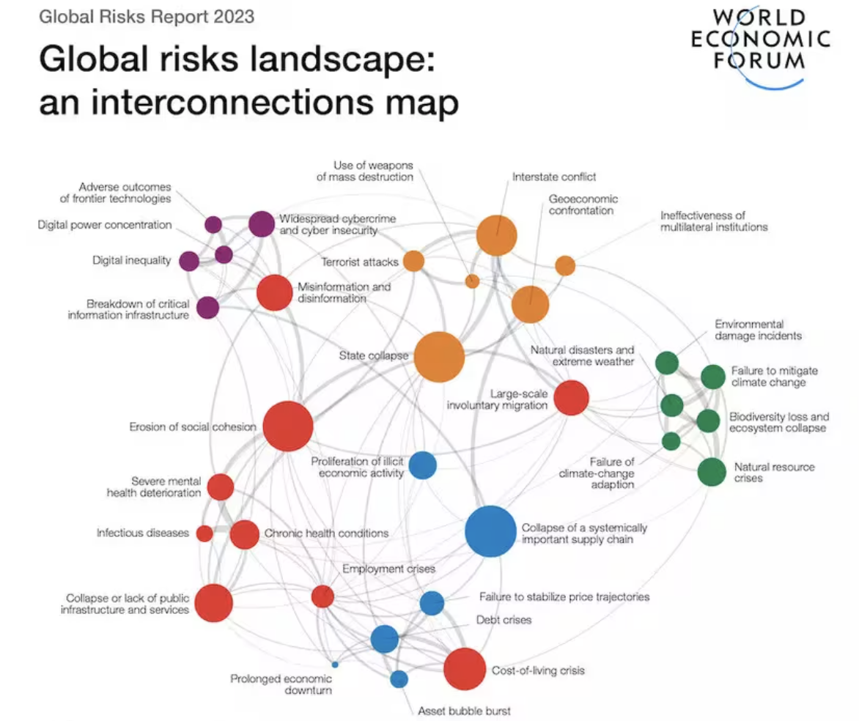

Slide 28
All the feelings
Photo credit: Jayme Elkins

Slide 29

How are you really?
“The consequence of ignoring the answer to this question is that “our inner lives are uncharted territory even to us, a risky place to explore.” And the cost is high, “If we don’t express our emotions, they pile up like a debt that will eventually come due.” Marc Brackett

Slide 30
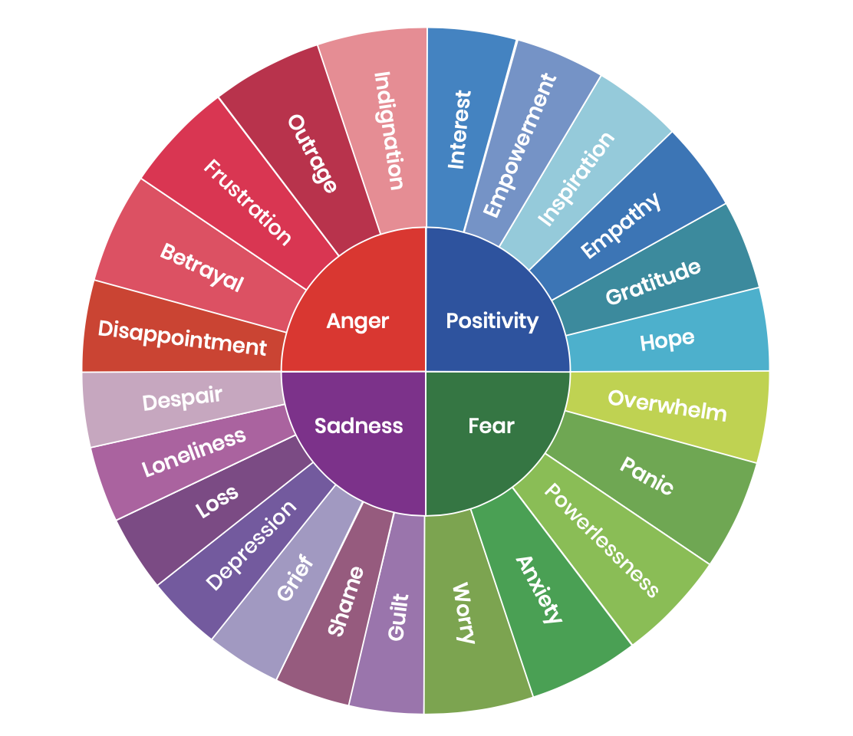
Reflect
Source: Climate Mental Health Network

Slide 31
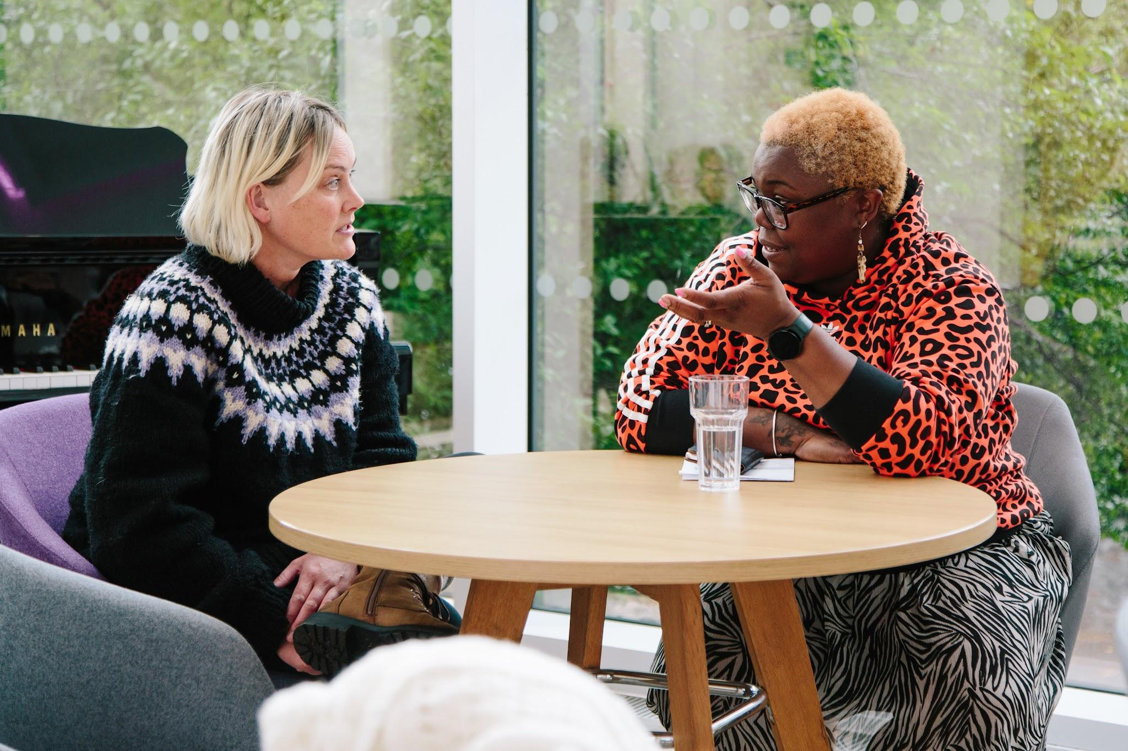
Connect

Slide 32
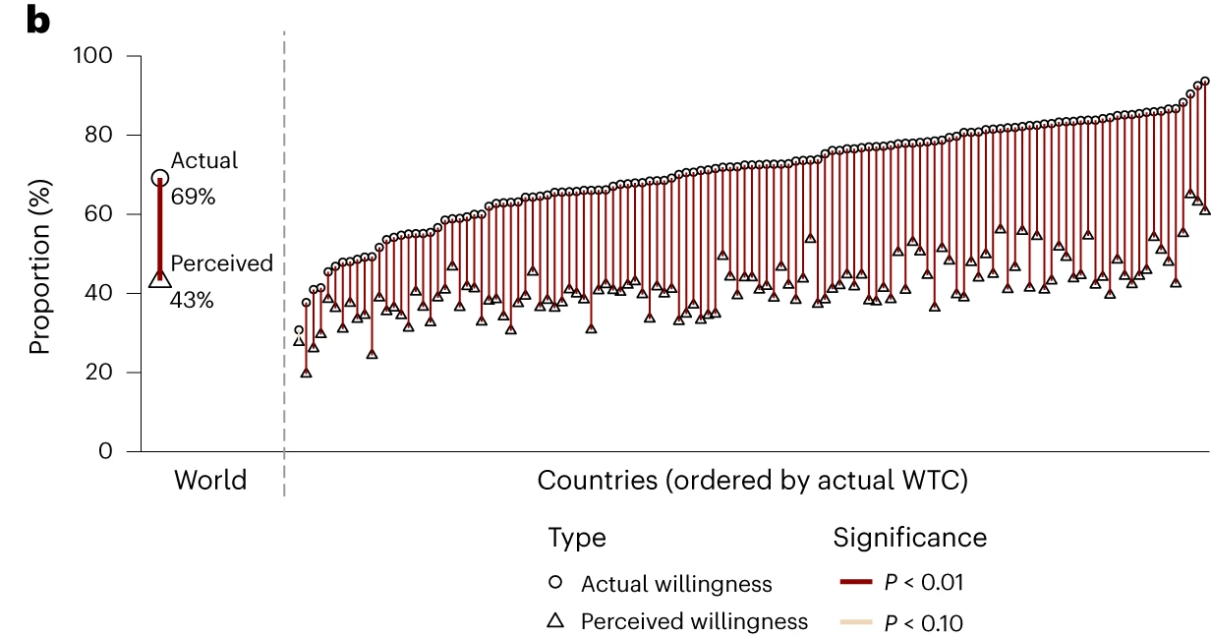
Actual vs perceived willingness to contribute to climate action in 125 countries. Across all countries, 69% are willing, but people believe the figure is only 43%.
Source: Andre, P., Boneva, T., Chopra, F. et al (2024)
Slide credit: Mike Berners-Lee
Notes:
Permission to use?
Andre, P., Boneva, T., Chopra, F. et al. Globally representative evidence on the actual and perceived support for climate action. Nat. Clim. Chang. (2024). https://doi.org/10.1038/s41558-024-01925-3
B&w

Slide 33
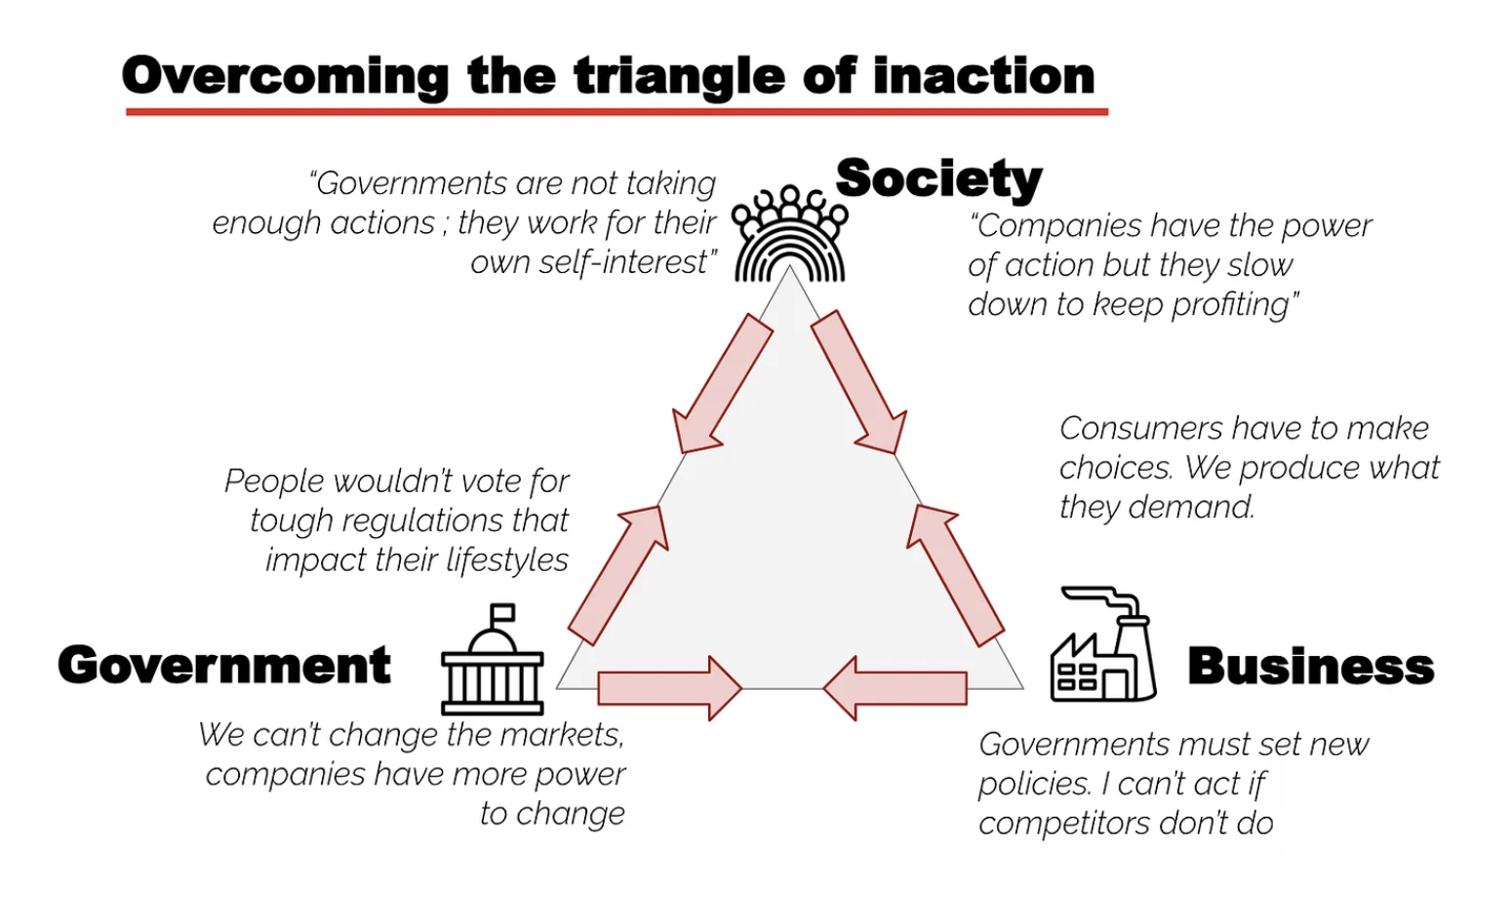

Slide 34
Systems
Notes:
So - , let’s zoom out - what’s the scale of the problem

Slide 35

Thinking in Systems
“The systems-thinking lens allows us to reclaim our intuition about whole systems and hone our abilities to understand parts, see interconnections, ask “what-if ” questions about possible future behaviors, and be creative and courageous about system redesign.” Donella Meadows

Slide 36
Thinking in Systems
“A change in purpose changes a system profoundly, even if every element and interconnection remains the same.” Donella Meadows

Slide 37
What is most needed?
What could I do?
My
response
Slide credit: Mike Berners-Lee

Slide 38
Thank you
Sophia Cheng | With Many Roots
Comms, training and engagement around the climate and ecological crisis.
sophia@withmanyroots.com
Notes:
Welcome and Intros
Who are you? Where are you?
A topic you love to talk about at the moment?
A silly topic you cannot have a sensible conversation about?

Slide 39
A whirlwind tour of resource and support
Trades Union Congress
Optimo
The Supply Chain Network
Forum for the Future
Aire Resilience Company
We Are Magpie
West Yorkshire Combined Authority
Social Tipping Points Toolkit
The Green Estate
If you would like to include something in the follow up email, please send details to Sam Herbert s.herbert@leeds.ac.uk
Notes:
CHAIR

